Slide 1
Unit 3 Arrays, Recursion, and Complexity
Lesson 8: Introduction to Arrays
Lesson 9: Classes Continued
Lesson 10: Arrays Continued
Lesson 11: Recursion, Complexity, and Searching and Sorting

Slide 2
Lesson 8: Introduction To Arrays

Slide 3
Lesson 8: Introduction To Arrays
Objectives:
Write programs that handle collections of similar items.
Declare array variables and instantiate array objects.
Manipulate arrays with loops.
Write methods to manipulate arrays.
Create parallel arrays and two-dimensional arrays.

Slide 4
Lesson 8: Introduction To Arrays
Vocabulary:
array
element
index
initializer list
logical size
multi-dimensional array
one-dimensional array
parallel arrays
physical size
ragged array
range bound error
subscript
two-dimensional array

Slide 5
8.1 Conceptual Overview
An array consists of an ordered collection of similar items.
An array has a single name, and the items in an array are referred to in terms of their position within the array.
An array makes it is as easy to manipulate a million test scores as it is three.

Slide 6
8.1 Conceptual Overview
Without arrays, a program with 20 test scores would look like this:
private String name;
private int test1, test2, test3, test4, test5,
test6, test7, test8, test9, test10,
test11, test12, test13, test14, test15,
test16, test17, test18, test19, test20;

Slide 7
8.1 Conceptual Overview
And the computation of the average score looks like this:
// Compute and return a student’s average
public int getAverage(){
int average;
average = (test1 + test2 + test3 + test4 + test5 +
test6 + test7 + test8 + test9 + test10 +
test11 + test12 + test13 + test14 + test15 +
test16 + test17 + test18 + test19 + test20) / 20;
return average;
}

Slide 8
8.1 Conceptual Overview
The items in an array are called elements.
For any particular array, all the elements must be of the same type.
The type can be any primitive or reference type.
For instance, we can have an array of test scores, an array of names, or even an array of student objects.
In figure 8-1 each array contains five elements, or has a length of five.
The first element in the array test is referred to as test[0], the second as test[1], and so on.

Slide 9
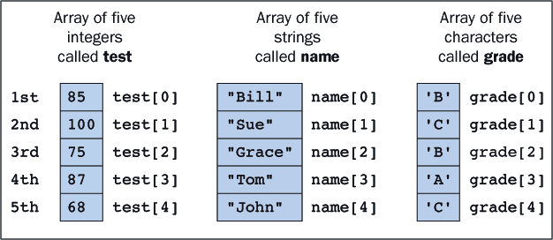
8.1 Conceptual Overview
The first element in the array test is referred to as test[0], the second as test[1], and so on.
An item's position within an array is called its index or subscript.

Slide 10
8.2 Simple Array Manipulations
First we declare and instantiate an array of 500 integer values.
By default, all of the values are initialized to 0:
Next, we declare some other variables:
int[] abc = new int[500];
int i = 3;
int temp;
double avFirstFive;

Slide 11
8.2 Simple Array Manipulations
The basic syntax for referring to an array element has the form:
Where <index> must be between 0 and the array's length less 1.
The subscript operator ([]) has the same precedence as the method selector (.).
<array name>[<index>]

Slide 12
8.2 Simple Array Manipulations
For example we assign values to the first five elements:
When assigning a value to the 500th element, we must remember that its index is 499, not 500:
abc[0] = 78; //1st element 78
abc[1] = 66; //2nd element 66
abc[2] = (abc[0] + abc[1]) / 2; //3rd element average of first two
abc[i] = 82; //4th element 82 because i is 3
abc[i + 1] = 94; //5th element 94 because i + 1 is 4
abc[499] = 76; //500th element 76

Slide 13
8.2 Simple Array Manipulations
The JVM checks the values of subscripts before using them and throws an ArrayIndexOutOfBoundsException if they are out of bounds (less than 0 or greater than the array length less 1).
The detection of a range bound error is similar to the JVM's behavior when a program attempts to divide by 0.
To compute the average of the first five elements, we could write:
avFirstFive = (abc[0] + abc[1] + abc[2] + abc[3] + abc[4])/5;

Slide 14
8.2 Simple Array Manipulations
It often happens that we need to interchange elements in an array.
// Initializations
. . .
abc[3] = 82;
abc[4] = 95;
i = 3;
. . .
// Interchange adjacent elements
temp = abc[i]; // temp now equals 82
abc[i] = abc[i + 1]; // abc[i] now equals 95
abc[i + 1] = temp; // abc[i + 1] now equals 82

Slide 15
8.2 Simple Array Manipulations
We frequently need to know an array's length.
The array itself makes this information available by means of a public instance variable called length:
System.out.println ("The size of abc is: " + abc.length);

Slide 16
8.3 Looping Through Arrays
Sum the Elements
The following code sums the numbers in the array abc.
Each time through the loop adds a different element to the sum. On the first iteration we add abc[0] and on the last abc[499].
int sum;
sum = 0;
for (int i = 0; i < 500; i++)
sum += abc[i];

Slide 17
8.3 Looping Through Arrays
Count the Occurrences
We can determine how many times a number x occurs in the array by comparing x to each element and incrementing count every time there is a match:
int x;
int count;
x = ...; //Assign some value to x
count = 0;
for (int i = 0; i < 500; i++){
if (abc[i] == x)
count++; //Found another element equal to x
}

Slide 18
8.3 Looping Through Arrays
Determine Presence or Absence
To determine if a particular number is present in the array, programmers can break out of the loop as soon as the first match is found.
The Boolean variable found indicates the outcome of the search.

Slide 19
8.3 Looping Through Arrays
Working With Arrays of Any Size
It is possible and also desirable to write code that works with arrays of any size.
Simply replace the literal 500 with a reference to the array's instance variable length in each of the loops.
For example, this code would sum the integers in an array of any size:
int sum;
sum = 0;
for (int i = 0; i < abc.length; i++)
sum += abc[i];

Slide 20
8.4 Declaring Arrays
Arrays are objects and must be instantiated before being used.
Several array variables can be declared in a single statement like this:
Or like this:
int[] abc, xyz;
abc = new int[500];
xyz = new int[10];
int[] abc = new int[500], xyz = new int[10];

Slide 21
8.4 Declaring Arrays
Array variables are null before they are assigned array objects.
Failure to assign an array object can result in a null pointer exception.
int[] abc;
abc[1] = 10; // runtime error: null pointer exception

Slide 22
8.4 Declaring Arrays
Because arrays are objects, two variables can refer to the same array as indicated in Figure 8-2 and the next segment of code:
int[] abc, xyz;
abc = new int[5]; // Instantiate an array of 5
integers
xyz = abc; // xyz and abc refer to the same array
xyz[3] = 100; // Changing xyz changes abc as well.
System.out.println (abc[3]); // 100 is displayed

Slide 23
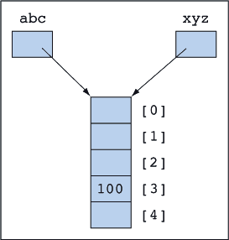
8.4 Declaring Arrays

Slide 24
8.4 Declaring Arrays
Arrays can be declared, instantiated, and initialized in one step.
The list of numbers between the braces is called an initializer list.
Here then are arrays of doubles, characters, Booleans, strings, and students:
int[] abc = {1,2,3,4,5} // abc now references an array of five integers.

Slide 25
8.4 Declaring Arrays
double[] ddd = new double[10];
char[] ccc = new char[10];
boolean[] bbb = new boolean[10];
String[] ggg = new String[10];
Student[] sss = new Student[10];
String str;
ddd[5] = 3.14;
ccc[5] = 'Z';
bbb[5] = true;
ggg[5] = "The cat sat on the mat.";
sss[5] = new Student();
sss[5].setName ("Bill");
str = sss[5].getName() + ggg[5].substring(7);
// str now equals "Bill sat on the mat."

Slide 26
8.4 Declaring Arrays
There is another way to declare array variables. but its use can be confusing.
Here it is:
int aaa[]; // aaa is an array variable.

Slide 27
8.5 Working with Arrays That Are Not Full
One might create an array of 20 ints but receive only 5 ints from interactive input.
This array has a physical size of 20 cells but a logical size of 5 cells currently used by the application.
From the application's perspective, the remaining 15 cells contain garbage.

Slide 28
8.5 Working with Arrays That Are Not Full
It is possible to track the array's logical size with a separate integer variable.
The following code segment shows the initial state of an array and its logical size:
Note that abc.length (the physical size) is 50, whereas size (the logical size) is 0
int[] abc = new int[50];
int size = 0;

Slide 29
8.5 Working with Arrays That Are Not Full
Processing Elements in an Array That Is Not Full
When the array is not full, one must replace the array's length with its logical size in the loop.
Here is the code for computing the sum of the integers currently available in the array abc:

Slide 30
8.5 Working with Arrays That Are Not Full
int[] abc[50];
int size = 0;
... code that puts values into some initial portion of the array and sets
the value of size ...
int sum = 0;
for (int i = 0; i < size; i++) // size contains //the number items in the array
sum += abc[i];

Slide 31
8.5 Working with Arrays That Are Not Full
Adding Elements to an Array
The simplest way to add a data element to an array is to place it after the last available item.
One must first check to see if there is a cell available and then remember to increment the array's logical size.
The following code shows how to add an integer to the end of array abc:

Slide 32
8.5 Working with Arrays That Are Not Full
if (size < abc.length){
abc[size] = anInt;
size++;
}
When size equals abc.length, the array is full.
The if statement prevents a range error from occurring.
Remember that Java arrays are of fixed size when they are instantiated, so eventually they become full.

Slide 33
8.5 Working with Arrays That Are Not Full
Removing Elements from an Array
Removing a data element from the end of an array requires no change to the array itself.
Simply decrement the logical size, thus preventing the application from accessing the garbage elements beyond that point.

Slide 34
8.6 Parallel Arrays
Suppose we want to keep a list of people's names and ages.
This can be achieved by using two arrays in which corresponding elements are related.
Thus, Bill's age is 20 and Mary's is 24.
String[] name = {"Bill", "Sue", "Shawn", "Mary", "Ann"};
int[] age = {20 , 21 , 19 , 24 , 20};

Slide 35
8.6 Parallel Arrays
Here is a segment of code that finds the age of a particular person.
In this example, the parallel arrays are both full and the loops use the instance variable length.
When the arrays are not full, the code will need an extra variable to track their logical sizes.

Slide 36
8.6 Parallel Arrays
String searchName;
int correspondingAge = -1;
int i;
searchName = ...; // Set this to the desired name
for (i = 0; i < name.length; i++){ // name.length is the array’s size
if (searchName.equals (name[i]){
correspondingAge = age[i];
break;
}
}
if (correspondingAge == -1)
System.out.println(searchName + " not found.");
else
System.out.println("The age is " + correspondingAge);

Slide 37
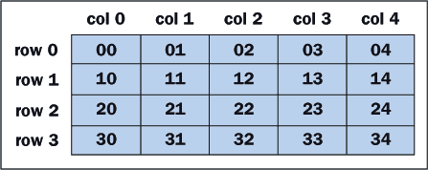
8.7 Two-Dimensional Arrays
A table of numbers, for instance, can be implemented as a two-dimensional array. Figure 8-3 shows a two-dimensional array with four rows and five columns.
Suppose we call the array table; then to indicate an element in table, we specify its row and column position, remembering that indexes start at 0:
x = table[2][3]; // Set x to 23, the value in (row 2, column 3)

Slide 38
8.7 Two-Dimensional Arrays
Sum the Elements
Here is code that sums all the numbers in table.
The outer loop iterates four times and moves down the rows.
Each time through the outer loop, the inner loop iterates five times and moves across a different row.

Slide 39
8.7 Two-Dimensional Arrays
int i, j;
int sum = 0;
for (i = 0; i < 4; i++){ // There are four rows: i = 0,1,2,3
for (j = 0; j < 5; j++){ // There are five columns: j = 0,1,2,3,4
sum += table[i][j];
}
}

Slide 40
8.7 Two-Dimensional Arrays
This segment of code can be rewritten without using the numbers 4 and 5.
The value table.length equals the number of rows,
Table[i].length is the number of columns in row i.
int i, j;
int sum = 0;
for (i = 0; i < table.length; i++){
for (j = 0; j < table[i].length; j++){
sum += table[i][j];
}
}

Slide 41
8.7 Two-Dimensional Arrays
Sum the Rows
We now compute the sum of each row separately and place the results in a one-dimensional array called rowSum.
This array has four elements, one for each row of the table.
The elements in rowSum are initialized to 0 automatically by virtue of the declaration.

Slide 42
8.7 Two-Dimensional Arrays
int i, j;
int[] rowSum = new int[4];
for (i = 0; i < table.length; i++){
for (j = 0; j < table[i].length; j++){
rowSum[i] += table[i][j];
}
}

Slide 43
8.7 Two-Dimensional Arrays
Declare and Instantiate
Declaring and instantiating two-dimensional arrays are accomplished by extending the processes used for one-dimensional arrays:
int[][] table; // The variable table can reference a
// two-dimensional array of integers
table = new int[4][5]; // Instantiate table as an array of size 4,
// each of whose elements will reference an array
// of 5 integers.

Slide 44
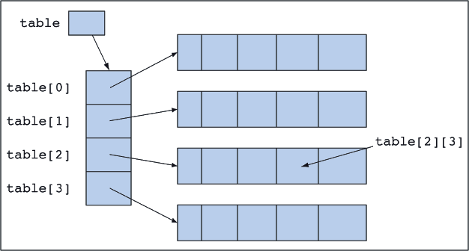
8.7 Two-Dimensional Arrays
The variable table references an array of four elements.
Each of these elements in turn references an array of five integers.

Slide 45
8.7 Two-Dimensional Arrays
Initializer lists can be used with two-dimensional arrays. This requires a list of lists.
The number of inner lists determines the number of rows, and the size of each inner list determines the size of the corresponding row.
The rows do not have to be the same size, but they are in this example:
int[][] table = {{ 0, 1, 2, 3, 4}, // row 0
{10,11,12,13,14}, // row 1
{20,21,22,23,24}, // row 2
{30,31,32,33,34}}; // row 3

Slide 46
8.7 Two-Dimensional Arrays
Variable Length Rows
Ragged arrays are rows of a two-dimensional arrays that are not all the same length.
int[][] table;
table = new int[4][]; // table has 4 rows
table[0] = new int[6]; // row 0 has 6 elements
table[1] = new int[10]; // row 1 has 10 elements
table[2] = new int[100]; // row 2 has 100 elements
table[3] = new int[1]; // row 3 has 1 element

Slide 47
8.8 Arrays and Methods
When any object is used as a parameter to a method, what actually gets passed is a reference to the object and not the object itself.
The actual and formal parameters refer to the same object, and changes the method makes to the object's state are still in effect after the method terminates.
In the figure, the method changes the student's name to Bill, and after the method finishes executing the name is still Bill.

Slide 48
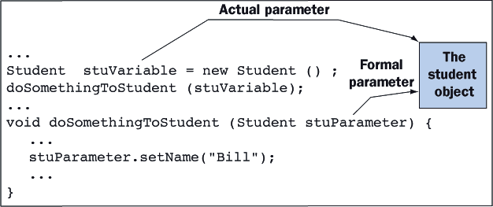
8.8 Arrays and Methods

Slide 49
8.8 Arrays and Methods
Arrays are objects, so the same rules apply.
When an array is passed as a parameter to a method, the method manipulates the array itself and not a copy.
Changes made to the array in the method are still in effect after the method has completed its execution.
A method can also instantiate a new object or a new array and return it using the return statement.

Slide 50
8.8 Arrays and Methods
Sum the Elements
The following method computes the sum of the numbers in an integer array.
When the method is written, there is no need to know the array's size.
The method works equally well with integer arrays of all sizes, as long as those arrays are full

Slide 51
8.8 Arrays and Methods
int sum (int[] a){
int i, result = 0;
for (i = 0; i < a.length; i++)
result += a[i];
return result;
}
Using the method is straightforward:
int[] array1 = {10, 24, 16, 78, -55, 89, 65};
int[] array2 = {4334, 22928, 33291};
...
if (sum(array1) > sum(array2)) ...

Slide 52
8.8 Arrays and Methods
Search for a Value
The code to search an array for a value is used so frequently in programs that it is worth placing in a method.
Here is a method to search an array of integers.
The method returns the location of the first array element equal to the search value or -1 if the value is absent:
int search (int[] a, int searchValue){
int location, i;
location = -1;
for (i = 0; i < a.length; i++){
if (a[i] == searchValue){
location = i;
break;
}
}
return location;
}

Slide 53
8.8 Arrays and Methods
Sum the Rows
Here is a method that instantiates a new array and returns it. The method computes the sum of each row in a two-dimensional array and returns a one-dimensional array of row sums. The method works even if the rows are not all the same size.
int[] sumRows (int[][] a){
int i, j;
int[] rowSum = new int[a.length];
for (i = 0; i < a.length; i++){
for (j = 0; j < a[i].length; j++){
rowSum[i] += a[i][j];
}
}
return rowSum;
}

Slide 54
8.8 Arrays and Methods
Here is code that uses the method.
We do not have to instantiate the array oneD because that task is done in the method sumRows.
int[][] twoD = {{1,2,3,4}, {5,6}, {7,8,9}};
int[] oneD;
oneD = sumRows (twoD); // oneD now references the array created and returned
// by the method sumRows. It equals {10, 11, 24}

Slide 55
8.9 Arrays of Objects
Arrays can hold objects of any type, or more accurately, references to objects.
For example, one can declare, instantiate and fill an array of students as follows:
// Declare and reserve 10 cells for student objects
Student[] studentArray = new Student[10];
// Fill array with students
for (int i = 0; i < studentArray.length; i++)
studentArray[i] = new Student("Student " + i, 70+i, 80+i, 90+i);

Slide 56
8.9 Arrays of Objects
When an array of objects is instantiated, each cell is null by default until reset to a new object.
The next code segment prints the average of all students in the studentArray. Pay special attention to the technique used to send a message to objects in an array:
// Print the average of all students in the array.
int sum = 0;
for (int i = 0; i < studentArray.length; i++)
sum += studentArray[i].getAverage(); // Send message to object in array
System.out.println("The class average is " + sum / accountArray.length);

Slide 57
Lesson 9: Classes Continued

Slide 58
Lesson 9: Classes Continued
Objectives:
Know when it is appropriate to include class (static) variables and methods in a class.
Understand the role of Java interfaces in a software system and define an interface for a set of implementing classes.
Understand the use of inheritance by extending a class.

Slide 59
Lesson 9: Classes Continued
Objectives:
Understand the use of polymorphism and know how to override methods in a superclass.
Place the common features (variables and methods) of a set of classes in an abstract class.
Understand the implications of reference types for equality, copying, and mixed-mode operations.

Slide 60
Lesson 8: Introduction To Arrays
Vocabulary:
abstract class
abstract method
class (static) method
class (static) variable
concrete class
exception
final method
inheritance
interface
overriding
postcondition
precondition

Slide 61
9.1 Class (static) Variables and Methods
Defining classes is only one aspect of object-oriented programming.
The real power of object-oriented programming comes from its capacity to reduce code and to distribute responsibilities for such things as error handling in a software system.

Slide 62
9.1 Class (static) Variables and Methods
Static Variables and Methods.
When information needs to be shared among all instances of a class, that information can be represented in terms of static variables and it can be accessed by means of static methods.
Interfaces.
A Java interface specifies the set of methods available to clients of a class.
Interfaces thus provide the glue that holds a set of cooperating classes together.

Slide 63
9.1 Class (static) Variables and Methods
Inheritance.
Java organizes classes in a hierarchy.
Classes inherit the instance variables and methods of the classes above them in the hierarchy.
A class can extend its inherited characteristics by adding instance variables and methods and by overriding inherited methods.
Inheritance provides a mechanism for reusing code and can greatly reduce the effort required to implement a new class.

Slide 64
9.1 Class (static) Variables and Methods
Abstract Classes.
Some classes in a hierarchy must never be instantiated, called abstract classes.
Their sole purpose is to define features and behavior common to their subclasses.
Polymorphism.
Polymorphism is when methods in different classes with a similar function are given the same name.
Polymorphism makes classes easier to use because programmers need to memorize fewer method names.
A good example of a polymorphic message is toString. Every object, no matter which class it belongs to, understands the toString message and responds by returning a string that describes the object.

Slide 65
9.1 Class (static) Variables and Methods
Preconditions and Postconditions.
Preconditions specify the correct use of a method
postconditions describe what will result if the preconditions are satisfied.
Exceptions for Error Handling.
When a method's preconditions are violated, a foolproof way to catch the errors is to throw exceptions, thereby halting program execution at the point of the errors
Reference Types.
The identity of an object and the fact that there can be multiple references to the same object are issues that arise when comparing two objects for equality and when copying an object.

Slide 66
9.1 Class (static) Variables and Methods
A class variable belongs to a class.
Storage is allocated at program startup and is independent of the number of instances created.
A class method is activated when a message is sent to the class rather than to an object.
The modifier static is used to designate class variables and methods.

Slide 67
9.1 Class (static) Variables and Methods
Counting the Number of Students Instantiated
Suppose we want to count all the student objects instantiated during the execution of an application.
To do so, we introduce a variable, which we call studentCount.
This variable is incremented in the constructor every time a student object is instantiated.
Because the variable is independent of any particular student object, it must be a class variable.

Slide 68
9.1 Class (static) Variables and Methods
Counting the Number of Students Instantiated
In addition, we need two methods to manipulate the studentCount variable:
one to initialize the variable to 0 at the beginning of the application
and the other to return the variable's value on demand.
These methods are called setStudentCount and getStudentCount, respectively. Because these methods do not manipulate any particular student object, they must be class methods.

Slide 69
9.1 Class (static) Variables and Methods
Modifying the Student Class
Following are the modifications needed to add the class variable and the two class methods in the Student class.
public class Student {
private String name;
... rest of the instance variables go here ...
public Student(){
studentCount++; // Increment the count when a student is
// instantiated
name = "";
test1 = 0;
test2 = 0;
test3 = 0;
}

Slide 70
9.1 Class (static) Variables and Methods
public void setName (String nm){
name = nm;
}
... rest of the methods without change go here ...
//--------------- class variables and methods ----------------
static private int studentCount;
static public void setStudentCount(int count){
studentCount = count;
}
static public int getStudentCount(){
return studentCount;
}
}

Slide 71
9.1 Class (static) Variables and Methods
Here is some code that illustrates the new capabilities of the Student class:
...
Student.setStudentCount (0); // Initialize count to 0
s1 = new Student(); // Instantiate a student object
...
s2 = new Student(); // Instantiate a student object
...
s3 = new Student(); // Instantiate a student object
messageBox (Student.getStudentCount()); // Displays 3

Slide 72
9.1 Class (static) Variables and Methods
Notice that class messages are sent to a class and not to an object.
Also, notice that we do not attempt to manipulate the studentCount variable directly because, in accordance with the good programming practice of information hiding, we declared the variable to be private.
In general, we use a static variable in any situation where all instances share a common data value.
We then use static methods to provide public access to these data.

Slide 73
9.1 Class (static) Variables and Methods
Class Constants
By using the modifier final in conjunction with static, we create a class constant.
The value of a class constant is assigned when the variable is declared, and it cannot be changed later.
To illustrate the use of class constants, we modify the Student class again by adding two class constants:
MIN_SCORE and
MAX_SCORE.

Slide 74
9.1 Class (static) Variables and Methods
public class Student {
private String name;
... rest of the instance variables go here ...
... no changes in the methods up to this point ...
public void setScore (int i, int score){
// Limit the score to the interval [MIN_SCORE, MAX_SCORE]
score = Math.max (MIN_SCORE, score);
score = Math.min (MAX_SCORE, score);
if (i == 1) test1 = score;
else if (i == 2) test2 = score;
else test3 = score;
}
... no changes in the methods here ...

Slide 75
9.1 Class (static) Variables and Methods
//--------------- static variables and methods ----------------
static final public int MIN_SCORE = 0;
static final public int MAX_SCORE = 100;
... no changes in the rest of the static stuff ...
}
The method max in class Math returns the maximum of its two parameters and min returns their minimum.
We declare the two class constants as public because clients might like to access them.

Slide 76
9.1 Class (static) Variables and Methods
Here is a segment of code that illustrates the Student class's new features:
s = new Student();
s.setScore(1, -20); // Too small, will be set to MIN_SCORE
s.setScore(2, 150); // Too large, will be set to MAX_SCORE
s.setScore(3, 55); // Value is acceptable
System.out.println (s); // Displays scores of 0, 100, and 55
System.out.println (Student.MIN_SCORE); // Displays 0
System.out.println (Student.MAX_SCORE); // Displays 100

Slide 77
9.1 Class (static) Variables and Methods
Rules for Using static Variables
There are two simple rules to remember when using static variables:
Class methods can reference only the static variables, and never the instance variables.
Instance methods can reference static and instance variables.

Slide 78
9.2 Java Interfaces The Client Perspective
The term interface is used in two different ways.
An interface is the part of a software system that interacts with human users.
An interface is a list of a class's public methods.

Slide 79
9.2 Java Interfaces The Client Perspective
The StandardPen, is just one of five classes that conform to the same interface.
Two others are:
WigglePen
RainbowPen
A WigglePen draws wiggly lines.
A RainbowPen draws randomly colored lines.
Each class has the same general behavior and respond to the same messages.

Slide 80
9.2 Java Interfaces The Client Perspective
The Pen Interface
Here is the code for the Pen interface:
// Pen.java
import java.awt.Color;
public interface Pen {
public void down();
public void drawString (String text);
public void home();
public void move (double distance);
public void move (double x, double y);
public void setColor (Color color);
public void setDirection (double direction);
public void setWidth (int width);
public String toString();
public void turn (double degrees);
public void up();
}

Slide 81
9.2 Java Interfaces The Client Perspective
The code consists of the signatures of the methods followed by semicolons.
The interface provides programmers with the information needed to use pens of any type correctly.
It is important to realize that an interface is not a class.

Slide 82
9.2 Java Interfaces The Client Perspective
Drawing with Different Types of Pens
import TurtleGraphics.*;
import java.awt.Color;
public class TestPens {
public static void main (String[] args){
// Declare three variables of the interface type called Pen.
Pen p1, p2, p3;
// Instantiate three different types of pens and
// associate them with the Pen variables.
p1 = new StandardPen();
p2 = new WigglePen();
p3 = new RainbowPen();

Slide 83
9.2 Java Interfaces The Client Perspective
// Draw a square with the standard pen.
for (int i = 1; i <= 4; i++){
p1.move(50);
p1.turn(90);
}
// Draw a square with the wiggle pen.
for (int i = 1; i <= 4; i++){
p2.move(50);
p2.turn(90);
}
// Draw a square with the rainbow pen.
for (int i = 1; i <= 4; i++){
p3.move(50);
p3.turn(90);
}
}
}

Slide 84
9.2 Java Interfaces The Client Perspective
The three pen variables (p1, p2, and p3) are declared as Pen, which is the name of the interface.
Then the variables are associated with different types of pen objects.
Each object responds to exactly the same messages, (listed in the Pen interface), but with slightly different behaviors.
This is an example of polymorphism.

Slide 85
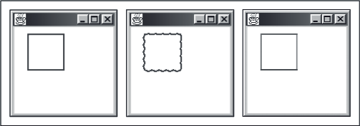
9.2 Java Interfaces The Client Perspective
The output from the program is shown in Figure 9-1.

Slide 86
9.3 Java Interfaces - The Implementation Perspective
The following code describes the interface shared by circles and rectangles.
import TurtleGraphics.Pen;
public interface Shape {
public double area();
public void draw (Pen p);
public double getXPos();
public double getYPos();
public void move (double xLoc, double yLoc);
public void stretchBy (double factor);
public String toString();
}

Slide 87
9.3 Java Interfaces - The Implementation Perspective
Classes Circle and Rect
The key feature is the phrase implements Shape.
The presence of this phrase implies that
Both classes implement all the methods listed in the Shape interface.
A variable declared as Shape can be associated with an object of either class.
public class Circle implements Shape{
...
}
public class Rect implements Shape{
...
}

Slide 88
9.3 Java Interfaces - The Implementation Perspective
Here is a complete implementation of the circle class:
import TurtleGraphics.Pen;
public class Circle implements Shape {
private double xPos, yPos;
private double radius;
public Circle() {
xPos = 0;
yPos = 0;
radius = 1;
}

Slide 89
9.3 Java Interfaces - The Implementation Perspective
public Circle (double xLoc, double yLoc, double r) {
xPos = xLoc;
yPos = yLoc;
radius = r;
}
public double area() {
return Math.PI * radius * radius;
}

Slide 90
9.3 Java Interfaces - The Implementation Perspective
public void draw (Pen p) {
double side = 2.0 * Math.PI * radius / 120.0;
p.up();
p.move (xPos + radius, yPos - side / 2.0);
p.setDirection (90);
p.down();
for (int i = 0; i < 120; i++){
p.move (side);
p.turn (3);
}
}
public double getXPos() {
return xPos;
}
public double getYPos() {
return yPos;
}

Slide 91
9.3 Java Interfaces - The Implementation Perspective
public void move (double xLoc, double yLoc) {
xPos = xLoc;
yPos = yLoc;
}
public void stretchBy (double factor) {
radius *= factor;
}
public String toString() {
String str = "CIRCLE\n"
+ "Radius: " + radius + "\n"
+ "(X,Y) Position: (" + xPos + "," + yPos + ")\n"
+ "Area: " + area();
return str;
}
}

Slide 92
9.3 Java Interfaces - The Implementation Perspective
Testing the Classes
We now write a small test program that instantiates a circle and a rectangle and subjects them to a few basic manipulations.
Embedded comments explain what is happening, and Figure 9-2 shows the output:

Slide 93
9.3 Java Interfaces - The Implementation Perspective
import TurtleGraphics.*;
import java.awt.Color;
import TerminalIO.KeyboardReader;
public class TestShapes {
public static void main (String[] args) {
// Declare and instantiate a pen, a circle and a rectangle
Pen p = new StandardPen();
Shape s1 = new Circle (20, 20, 20);
Shape s2 = new Rect (-20, -20, 10, 20);
// Draw the circle and rectangle
s1.draw (p);
s2.draw (p);
// Display a description of the circle and rectangle
System.out.println (s1); // toString method called implicitly
System.out.println (s2); // toString method called implicitly

Slide 94
9.3 Java Interfaces - The Implementation Perspective
// Pause until the user is ready to continue
KeyboardReader reader = new KeyboardReader();
reader.pause();
// Erase the circle and rectangle
p.setColor (Color.white);
s1.draw (p);
s2.draw (p);
p.setColor (Color.red);
// Move the circle and rectangle, change their size, and redraw
s1.move (30, 30); s2.move (-30, -30);
s1.stretchBy (2); s2.stretchBy (2);
s1.draw (p); s2.draw (p);
}
}

Slide 95
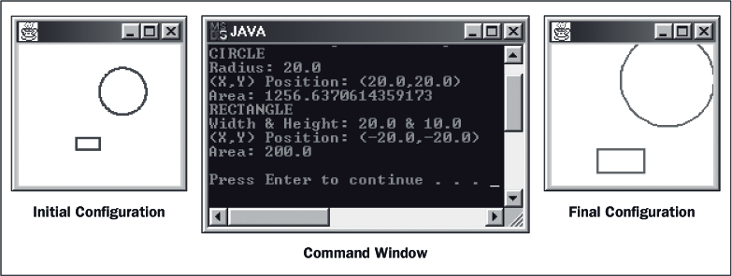
9.3 Java Interfaces - The Implementation Perspective

Slide 96
9.3 Java Interfaces - The Implementation Perspective
Final Observations
An interface contains only methods, never variables.
The methods in an interface are usually public.
If more than one class implements an interface, its methods are polymorphic.
A class can implement methods in addition to those listed in the interface.
A class can implement more than one interface.
Interfaces can be organized in an inheritance hierarchy.

Slide 97
9.4 Code Reuse Through Inheritance
Review of Terminology
Figure 9-3 shows part of a class hierarchy, with Object as always at the root (the top position in an upside down tree).
Below Object are its subclasses, but we show only one, which we call AAA.
Because AAA is immediately below Object, we say that it extends Object. Similarly, BBB and CCC extend AAA.
The class immediately above another is called its superclass, so AAA is the superclass of BBB and CCC.
A class can have many subclasses, and all classes, except Object, have exactly one superclass. The descendants of a class consist of its subclasses, plus their subclasses, etc.

Slide 98
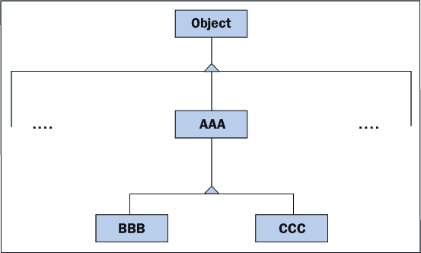
9.4 Code Reuse Through Inheritance

Slide 99
9.4 Code Reuse Through Inheritance
Wheel as a Subclass of Circle
As our first illustration of inheritance, we implement the class Wheel as a subclass of Circle.
A wheel is just a circle with spokes, so much of the code needed to implement Wheel is already in Circle.

Slide 100
9.4 Code Reuse Through Inheritance
import TurtleGraphics.Pen;
public class Wheel extends Circle {
private int spokes; // The number of spokes in the wheel
// xPos, yPos, and radius are inherited from Circle
public Wheel() {
super(); // Activate the constructor Circle() to
// initialize xPos, yPos, and radius.
spokes = 0; // Now initialize spokes.
}
public Wheel (double xLoc, double yLoc, double r, int s) {
super (xLoc, yLoc, r); // Activate the constructor
// Circle (double xLoc, double yLoc, double r)
// to initialize xPos, yPos, and radius.
spokes = s; // Now initialize spokes.
}

Slide 101
9.4 Code Reuse Through Inheritance
public void draw (Pen p) {
// Draw the wheel’s rim by calling the draw method in the superclass.
super.draw (p);
// Draw the spokes
for (int i = 1; i <= spokes; i++){
p.up();
p.move (xPos, yPos);
p.setDirection (i * 360.0 / spokes);
p.down();
p.move (radius);
}
}

Slide 102
9.4 Code Reuse Through Inheritance
public void setSpokes (int s) {
spokes = s;
}
public String toString() {
String str = "WHEEL\n"
+ "Radius: " + radius + "\n"
+ "Spokes: " + spokes + "\n"
+ "(X,Y) Position: (" + xPos + "," + yPos + ")\n"
+ "Area: " + area();
return str;
}
}

Slide 103
9.4 Code Reuse Through Inheritance
Testing the Wheel Class
Below is a test program that draws a circle and a wheel
// Declare and instantiate a pen, a circle and a wheel
Pen p = new StandardPen();
Shape s1 = new Circle (20, 20, 20);
Shape s2 = new Wheel (-20, -20, 20, 6);
// Draw the circle and wheel
s1.draw (p);
s2.draw (p);

Slide 104
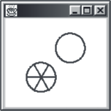
9.4 Code Reuse Through Inheritance
Figure 9-4 shows the results of this program:

Slide 105
9.4 Code Reuse Through Inheritance
Detailed Explanation
CLASS HEADER
In the class header, we see that Wheel extends Circle, thereby indicating that it is a subclass of Circle and inherits all of Circle's variables and methods.
The clause "implements Shape" is omitted from the header because Wheel inherits this property from Circle automatically.

Slide 106
9.4 Code Reuse Through Inheritance
VARIABLES
The variable spokes, indicating the number of spokes in a wheel, is the only variable declared in the class.
The other variables (xPos, yPos, and radius) are inherited from Circle.
In order to reference these variables in Wheel methods, Circle must be modified slightly.

Slide 107
9.4 Code Reuse Through Inheritance
In Circle, these variables must be declared protected instead of private.
Protected indicates that Circle's descendents can access the variables while still hiding them from all other classes.
protected double xPos, yPos;
protected double radius;

Slide 108
9.4 Code Reuse Through Inheritance
PROTECTED METHODS
Methods can be designated as protected also.
A protected method is accessible to a class's descendants, but not to any other classes in the hierarchy.
CONSTRUCTORS AND SUPER
Constructors in class Wheel explicitly initialize the variable spokes.
Constructors in the superclass Circle initialize the remaining variables (xPos, yPos, and radius).
The keyword super is used to activate the desired constructor in Circle, and the parameter list used with super determines which constructor in Circle is called.
When used in this way, super must be the first statement in Wheel's constructors.

Slide 109
9.4 Code Reuse Through Inheritance
OTHER METHODS AND SUPER
Super can also be used in methods other than constructors, but in a slightly different way.
It can appear any place within a method.,
It takes the form:
Such code activates the named method in the superclass (note that the two methods are polymorphic).
super.<method name> (<parameter list>);
this.<method name> (<parameter list>); // Long form
// or
<method name> (<parameter list>); // Short form

Slide 110
9.4 Code Reuse Through Inheritance
WHY SOME METHODS ARE MISSING
Not all the Shape methods are implemented in Wheel, since they are inherited unchanged from Circle.
For instance, if the move message is sent to a wheel object, the move method in Circle is activated.
WHY SOME METHODS ARE MODIFIED
Whenever a wheel object must respond differently to a message than a circle object, the corresponding method must be redefined in class Wheel.

Slide 111
9.4 Code Reuse Through Inheritance
The methods draw and toString are examples.
When convenient, the redefined method can use super to activate a method in the superclass.
WHY THERE ARE EXTRA METHODS
A subclass often has methods that do not appear in its superclass.
The method setSpokes is an example.

Slide 112
9.4 Code Reuse Through Inheritance
WHAT MESSAGES CAN BE SENT TO A WHEEL
Because Wheel is a subclass of Circle, it automatically implements Shape.
A variable of type Shape can be instantiated as a new Wheel and can receive all Shape messages:
Shape someShape = new Wheel();
someShape.<any Shape message>;

Slide 113
9.4 Code Reuse Through Inheritance
The variable someShape cannot be sent the message setSpokes even though it is actually a wheel.
From the compiler's perspective, someShape is limited to receiving messages in the Shape interface.

Slide 114
9.4 Code Reuse Through Inheritance
There are two ways to circumvent this limitation.
The variable someShape is either declared as type Wheel in the first place,
or it is cast to class Wheel when it is sent a message unique to class Wheel.
Here is an example:
Wheel v1 = new Wheel();
Shape v2 = new Wheel();
v1.setSpokes (6); // v1 can be sent all Wheel messages
((Wheel)v2).setSpokes (6); // v2 must first be cast to class Wheel before
// being sent this message

Slide 115
9.5 Inheritance and Abstract Classes
Inheritance provides a mechanism for reducing duplication of code.
To illustrate, we define a new class that is a superclass of Circle and Rect and contains all the variables and methods common to both.
We will never have any reason to instantiate this class, so we will make it an abstract class,
The classes that extend this class and that are instantiated are called concrete classes.

Slide 116
9.5 Inheritance and Abstract Classes
Because AbstractShape is going to implement Shape, it must include all the Shape methods, even those, such as area, that are completely different in the subclasses and share no code.
Methods in AbstractShape, such as area, for which we cannot write any code, are called abstract methods, and we indicate that fact by including the word abstract in their headers.

Slide 117
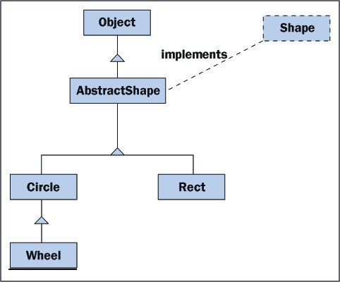
9.5 Inheritance and Abstract Classes
Our extended hierarchy of classes is shown in Figure 9-5:

Slide 118
9.5 Inheritance and Abstract Classes
It takes a lot of code to implement all these classes; however, the code is straightforward, and the embedded comments explain the tricky parts.
Pay particular attention to the attribute final, which is used for the first time in class AbstractShape.
A final method is a method that cannot be overridden by a subclass.

Slide 119
9.6 Some Observations About Interfaces and Inheritance
A Java interface has a name and consists of a list of method headers.
One or more classes can implement the same interface.
If a variable is declared to be of an interface type, then it can be associated with an object from any class that implements the interface.
If a class implements an interface, then all its subclasses do so implicitly.
A subclass inherits all the characteristics of its superclass. To this basis, the subclass can add new variables and methods or modify inherited methods.

Slide 120
9.6 Some Observations About Interfaces and Inheritance
Characteristics common to several classes can be collected in a common abstract superclass that is never instantiated.
An abstract class can contain headers for abstract methods that are implemented in the subclasses.
A class's constructors and methods can utilize constructors and methods in the superclass.
Inheritance reduces repetition and promotes the reuse of code.
Interfaces and inheritance promote the use of polymorphism.

Slide 121
9.6 Some Observations About Interfaces and Inheritance
Implementation, Extension, Overriding, and Finality
You may have noticed that there are four ways in which methods in a subclass can be related to methods in a superclass:
Implementation of an abstract method: Each subclass is forced to implement the abstract methods specified in its superclass. Abstract methods are thus a means of requiring certain behavior in all subclasses.

Slide 122
9.6 Some Observations About Interfaces and Inheritance
Extension: There are two kinds of extension:
a. The subclass method does not exist in the superclass.
b. The subclass method invokes the same method in the superclass and also extends the superclass's behavior with its own operations.
Overriding: In this case, the subclass method does not invoke the superclass method. Instead, the subclass method is intended as a complete replacement of the superclass method.
Finality: The method in the superclass is complete and cannot be modified by the subclasses. We declare such a method to be final.

Slide 123
9.6 Some Observations About Interfaces and Inheritance
Working Without Interfaces
Without the Shape interface, the implementation of AbstractShape remains the same except for the header:
Defining a variable as AbstractShape allows the variable to associate with objects from any shape class:
abstract public class AbstractShape {
AbstractShape s1, s2, s3;
s1 = new Circle();
s2 = new Rect();
s3 = new Wheel();
s2.<any message in AbstractShape>;

Slide 124
9.6 Some Observations About Interfaces and Inheritance
Because the AbstractShape class contains a list of all the shape methods, we can send any of the shape messages to the variables s1, s2, and s3.
Of course, we still cannot send the setSpokes message to s3 without first casting s3 to the Wheel class.

Slide 125
9.7 Acceptable Classes for Parameters and Return Values
The rules of Java state that in any situation in which an object of class BBB is expected, it is always acceptable to substitute an object of a subclass but never of a superclass.
This is because a subclass of BBB inherits all of BBB's methods, while no guarantees can be made about the methods in the superclass.

Slide 126
9.7 Acceptable Classes for Parameters and Return Values
The following code segment illustrates these points:
AbstractShape s;
Circle c;
Wheel w;
s = new Circle(); // Accepted by the compiler
c = new Circle(); // Accepted by the compiler
w = new Circle(); // Rejected by the compiler
c = new Wheel(); // Accepted by the compiler

Slide 127
9.7 Acceptable Classes for Parameters and Return Values
Rectangle In, Circle Out
The first example takes a rectangle as an input parameter and returns a circle.
The circle has the same area and position as the rectangle.
The method makes no changes to the rectangle, and it has to instantiate the circle:

Slide 128
9.7 Acceptable Classes for Parameters and Return Values
static private Circle makeCircleFromRectangle (Rect rectangle){
double area = rectangle.area();
double radius = Math.sqrt (area / Math.PI);
Circle circle = new Circle (rectangle.getXPos(),
rectangle.getYPos(),
radius);
return circle;
}

Slide 129
9.7 Acceptable Classes for Parameters and Return Values
Any Shape In, Circle Out
We now modify the previous method so that it accepts any shape as an input parameter - circle, rectangle, or wheel.
The fact that all shapes understand the area method makes the task easy:
static private Circle makeCircleFromAnyShape (Shape shape){
double area = shape.area();
double radius = Math.sqrt (area / Math.PI);
Circle circle = new Circle (shape.getXPos(),
shape.getYPos(),
radius);
return circle;
}

Slide 130
9.7 Acceptable Classes for Parameters and Return Values
Any Shape In, Any Shape Out
It is also possible for a method to return an arbitrary rather than a specific shape.
The next method has two input parameters.
The first parameter is a shape, and the second indicates the type of shape to return:

Slide 131
9.7 Acceptable Classes for Parameters and Return Values
static private Shape makeOneShapeFromAnother (Shape inShape, String type){
Shape outShape; // declare outShape
double area, radius, width, height;
double x = inShape.getXPos();
double y = inShape.getYPos();
area = inShape.area();
if (type.equals ("circle")){
radius = Math.sqrt (area / Math.PI);
outShape = new Circle (x, y, radius); // assign a circle
}
else if (type.equals ("rectangle")){
width = height = Math.sqrt (area);
outShape = new Rect (x, y, width, height); // assign a rectangle
}
else{ // it is a wheel
radius = Math.sqrt (area / Math.PI);
outShape = new Wheel (x, y, radius, 6); // assign a wheel
}
return outShape;
}

Slide 132
9.7 Acceptable Classes for Parameters and Return Values
Below is a test of the above method with the program's output shown in Figure 9-9.
public class TestShapes {
public static void main (String[] args){
Rect rect;
Shape shape1, shape2, shape3;
rect = new Rect (1,1,4,6);
shape1 = makeOneShapeFromAnother (rect, "circle");
shape2 = makeOneShapeFromAnother (rect, "rectangle");
shape3 = makeOneShapeFromAnother (rect, "wheel");

Slide 133
9.7 Acceptable Classes for Parameters and Return Values
System.out.println ("\nRectangle Area: " + rect.area() +
"\nCircle Area: " + shape1.area() +
"\nRectangle Area: " + shape2.area() +
"\nWheel Area: " + shape3.area());
}
static private Shape makeOneShapeFromAnother (Shape inShape,
String type){
... code as shown above ...
}
}

Slide 134
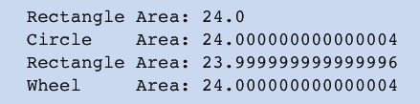
9.7 Acceptable Classes for Parameters and Return Values
FIGURE 9-9
Areas of various shapes made from a rectangle

Slide 135
9.8 Error Handling with Classes
In the following code, a class's mutator method returns a boolean value to indicate whether the operation has been successful or an error has occurred and the operation has failed.
The class also provides a method that returns a string that states a rule describing the valid use of the mutator method.

Slide 136
9.8 Error Handling with Classes
// In the Employee class
public String getHoursRules(){
return "between 1 and 60, inclusive";
}
public boolean setHours(int hrs){
if (!(1 <= hrs && hrs <= 60))
return false;
else{
hours = hrs;
return true;
}
}
// In the client that uses an Employee object
// Input the hours worked until valid
while (!emp.setHours(reader.readInt("Hours worked(" + emp.getHoursRules()
+ "): ")));

Slide 137
9.8 Error Handling with Classes
Preconditions and Postconditions
Think of preconditions and postconditions as the subject of a conversation between the user and implementer of a method.
Here is the general form of the conversation:
Implementer: "Here are the things that you must guarantee to be true before my method is invoked. They are its preconditions."
User: "Fine. And what do you guarantee will be the case if I do that?"
Implementer: "Here are the things that I guarantee to be true when my method finishes execution. They are its postconditions."

Slide 138
9.8 Error Handling with Classes
A method's preconditions describe what should be true before it is called. A method’s postconditions describe what will be true after it has finished executing.
Preconditions describe the expected values of parameters and instance variables that the method is about to use.
Postconditions describe the return value and any changes made to instance variables.
If the caller does not meet the preconditions, then the method probably will not meet the postconditions.

Slide 139
9.8 Error Handling with Classes
In most programming languages, preconditions and postconditions are conveniently written as comments placed directly above a method's header.
Let us add such documentation to a method header for the Student method setScore.
There are preconditions on each of the method's parameters:
The parameter i, which represents the position of the score, must be greater than or equal to 1 and less than or equal to 3.
The parameter score must be greater than or equal to 0 and less than or equal to 100.

Slide 140
9.8 Error Handling with Classes
The method's postcondition states that the test score at position i has been set to score.
We now return the boolean value true if the preconditions have been satisfied or false otherwise. Here is the code:
/*
* Precondition: 1 <= i <= 3
* Precondition: 0 <= score <= 100
* Postcondition: test score at position i is set to score
* Returns: true if the preconditions are satisfied or false otherwise
*/
public boolean setScore(int i, int score){
if (i < 1 || i > 3 || score < 0 || score > 100)
return false;
if (i == 1) test1 = score;
else if (i == 2) test2 = score;
else test3 = score;
return true;
}

Slide 141
9.9 Exceptions
Examples of Exceptions
Java provides a hierarchy of exception classes that represent the most commonly occurring exceptions.
Following is a list of some of the commonly used exception classes in the package java.lang:

Slide 142
9.9 Exceptions
Exception
RuntimeException
ArithmeticException
IllegalArgumentException
IllegalStateException
IndexOutOfBoundsException
StringIndexOutOfBoundsException
ArrayIndexOutOfBoundsException
NullPointerException
UnsupportedOperationException

Slide 143
9.9 Exceptions
Java throws an arithmetic exception when a program attempts to divide by 0
A null pointer exception occurs when a program attempts to send a message to a variable that does not reference an object.
An array index out of bounds exception is thrown when the integer in an array subscript operator is less than 0 or greater than or equal to the array's length.

Slide 144
9.9 Exceptions
Other types of exceptions, such as illegal state exceptions and illegal argument exceptions, can be used to enforce preconditions on methods.
Other packages, such as java.util, define more types of exceptions.
In general, you determine which preconditions you wish to enforce, and then choose the appropriate type of exception to throw from Java's repertoire.

Slide 145
9.9 Exceptions
The syntax of the statement to throw an exception is
Where <a string> is the message to be displayed.
When you are in doubt about which type of exception to throw, you can fall back on a RuntimeException.
throw new <exception class>(<a string>);
if (number < 0)
throw new RuntimeException("Number should be nonnegative");

Slide 146
9.9 Exceptions
Throwing Exceptions to Enforce Preconditions
A more hard-nosed approach to error handling is to have a class throw exceptions to enforce all of its methods' preconditions.
We will throw an IllegalArgumentException if either parameter violates the preconditions.
Because the method either succeeds in setting a score or throws an exception, it returns void instead of a boolean value.

Slide 147
9.9 Exceptions
The method header summarizes our error handling:
/*
* Precondition: 1 <= i <= 3
* Precondition: 0 <= score <= 100
* Postcondition: test score at position i is set to score
* throws IllegalArgumentException if i < 1 or i > 3
* throws IllegalArgumentException if score < 0 or score > 100
*/
public void setScore(int i, int score){
if (i < 1 || i > 3)
throw new IllegalArgumentException("i must be >= 1 and <= 3");
if (score < 0 || score > 100)
throw new IllegalArgumentException("score must be >= 0 and <= 100");
if (i == 1) test1 = score;
else if (i == 2) test2 = score;
else test3 = score;
}

Slide 148
9.9 Exceptions
Catching an Exception
The use of exceptions can make a server's code pretty fool proof.
Clients must still check the preconditions of such methods if they do not want these exceptions to halt their programs with run-time errors.
There are two ways to do this:

Slide 149
9.9 Exceptions
Use a simple if-else statement to ask the right questions about the parameters before calling a method.
Embed the call to the method within a try-catch statement.
The try-catch statement allows a client to
attempt the call of a method whose preconditions might be violated,
catch any exceptions that the method might throw and respond to them gracefully.

Slide 150
9.9 Exceptions
For example, here is some code that displays the exception's error message in the terminal window instead of halting the program with the same message and a call trace:
When the setScore method throws the IllegalStateException, the computer passes it as a parameter to the catch clause, which assumes immediate control and continues execution.
Student s = new Student("Bill", 100, 80, 75);
try{
s.setScore(4, 85);
}catch(IllegalStateException e){
System.out.println(e);
}

Slide 151
9.9 Exceptions
Suppose a method can throw two different types of exceptions, such as IllegalArgumentException and IllegalStateException.
To catch either one of these, one can include two catch clauses:
try{
someObject.someMethod(param1, param2);
}catch(IllegalStateException e){

Slide 152
9.9 Exceptions
System.out.println(e);
}catch(IllegalArgumentException e){
System.out.println(e);
}
The computer runs down the list of catch clauses until the exception's type matches that of a parameter or no match is found.
If no match is found, the exception is passed up the call chain.

Slide 153
9.9 Exceptions
To guarantee that any exception is caught, you can use the generic Exception class, which matches any exception type:
try{
s.setScore(4, 200);
}catch(Exception e){
System.out.println(e);
}

Slide 154
9.10 Reference Types, Equality, and Object Identity
It is possible for more than one variable to point to the same object, known as aliasing.
Aliasing, occurs when the programmer assigns one object variable to another.
It is also possible, for two object variables to refer to distinct objects of the same type.

Slide 155
9.10 Reference Types, Equality, and Object Identity
Comparing Objects for Equality
The possibility of aliasing can lead to unintended results when comparing two object variables for equality.
There are two ways to do this:
Use the equality operator ==.
Use the instance method equals.
This method is defined in the Object class and uses the == operator by default.

Slide 156
9.10 Reference Types, Equality, and Object Identity
Consider the following code segment, which reads a string from the keyboard, uses both methods to compare this string to a string literal, and outputs the results:
String str = reader.readString(); // Read string from keyboard.
System.out.println (str == "Java"); // Displays false no matter what
// string was entered.
System.out.println (str.equals ("Java")); // Displays true if the string
// entered was "Java", and false
// otherwise.

Slide 157
9.10 Reference Types, Equality, and Object Identity
Following is the explanation:
The objects referenced by the variable str and the literal "Java" are two different string objects in memory, even though the characters they contain might be the same.
The first string object was created in the keyboard reader during user input; the second string object was created internally within the program.

Slide 158
9.10 Reference Types, Equality, and Object Identity
The operator == compares the references to the objects, not the contents of the objects.
Thus, if the two references do not point to the same object in memory, == returns false.
Because the two strings in our example are not the same object in memory, == returns false.

Slide 159
9.10 Reference Types, Equality, and Object Identity
The method equals returns true, even when two strings are not the same object in memory, if their characters happen to be the same. If at least one pair of characters fails to match, the method equals returns false.
A corollary of these facts is that the operator != can return true for two strings, even though the method equals also returns true.
To summarize, == tests for object identity, whereas equals tests for structural similarity as defined by the implementing class.

Slide 160
9.10 Reference Types, Equality, and Object Identity
The operator == can also be used with other objects, such as buttons and menu items.
In these cases, the operator tests for object identity: a reference to the same object in memory.
With window objects, the use of == is appropriate because most of the time we want to compare references.
For other objects, however, the use of == should be avoided.

Slide 161
9.10 Reference Types, Equality, and Object Identity
Copying Objects
The attempt to copy an object with a simple assignment statement can cause a problem.
The following code creates two references to one student object when the intent is to copy the contents of one student object to another:
Student s1, s2;
s1 = new Student ("Mary", 100, 80, 75);
s2 = s1; // s1 and s2 refer to the same object

Slide 162
9.10 Reference Types, Equality, and Object Identity
When clients of a class might copy objects, there is a standard way of providing a method that does so.
The class implements the Java interface Cloneable.
This interface authorizes the method clone, which is defined in the Object class, to construct a field-wise copy of the object.

Slide 163
9.10 Reference Types, Equality, and Object Identity
We now can rewrite the foregoing code so that it creates a copy of a student object:
Note that == returns false and equals returns true for an object and its clone.
Student s1, s2;
s1 = new Student ("Mary", 100, 80, 75);
s2 = s1.clone(); // s1 and s2 refer to different objects

Slide 164
9.10 Reference Types, Equality, and Object Identity
The implementation of the clone method returns a new instance of Student with the values of the instance variables from the receiver student.
Here is the code for method clone:
// Clone a new student
public Object clone(){
return new Student (name, test1, test2, test3);
}

Slide 165
9.10 Reference Types, Equality, and Object Identity
Many of Java's standard classes, such as String, already implement the Cloneable interface, so they include a clone method.
When instance variables of a class are themselves objects that are cloneable, it is a good idea to send them the clone message to obtain copies when implementing the clone method for that class.
This process is called deep copying and can help minimize program errors.

Slide 166
Lesson 10: Arrays Continued

Slide 167
Lesson 10: Arrays Continued
Objectives:
Use String methods appropriately.
Write a method for searching an array.
Understand why a sorted array can be searched more efficiently than an unsorted array.
Write a method to sort an array.

Slide 168
Lesson 10: Arrays Continued
Objectives:
Write methods to perform insertions and removals at given positions in an array.
Understand the issues involved when working with arrays of objects.
Perform simple operations with Java's ArrayList class.

Slide 169
Lesson 10: Arrays Continued
Vocabulary:
binary search
bubble sort
immutable object
insertion sort
linear search
modal
selection sort
substring
wrapper class

Slide 170
10.1 Advanced Operations on Strings
Consider the problem of extracting words from a line of text.
To obtain the first word, we could copy the string's characters to a new string until we reach the first space character in the string (assuming the delimiter between words is the space) or we reach the length of the string.
Here is a code segment that uses this strategy:

Slide 171
10.1 Advanced Operations on Strings
// Create a sample string
String original = "Hi there!";
// Variable to hold the first word, set to empty string
String word = "";
// Visit all the characters in the string
for (int i = 0; i < original.length(); i++){
// Or stop when a space is found
if (original.charAt(i) == ' ')
break;
// Add the non-space character to the word
word += original.charAt(i);
}

Slide 172
10.1 Advanced Operations on Strings
As you can see, this code combines the tasks of finding the first space character and building a substring of the original string.
The problem is solved much more easily by using two separate String methods that are designed for these tasks.
String original = "Hi there!";
// Search for the position of the first space
int endPosition = original.indexOf(' ');
// If there is no space, use the whole string
if (endPosition == -1)
endPosition = original.length();
// Extract the first word
String word = original.substring(0, endPosition);

Slide 173
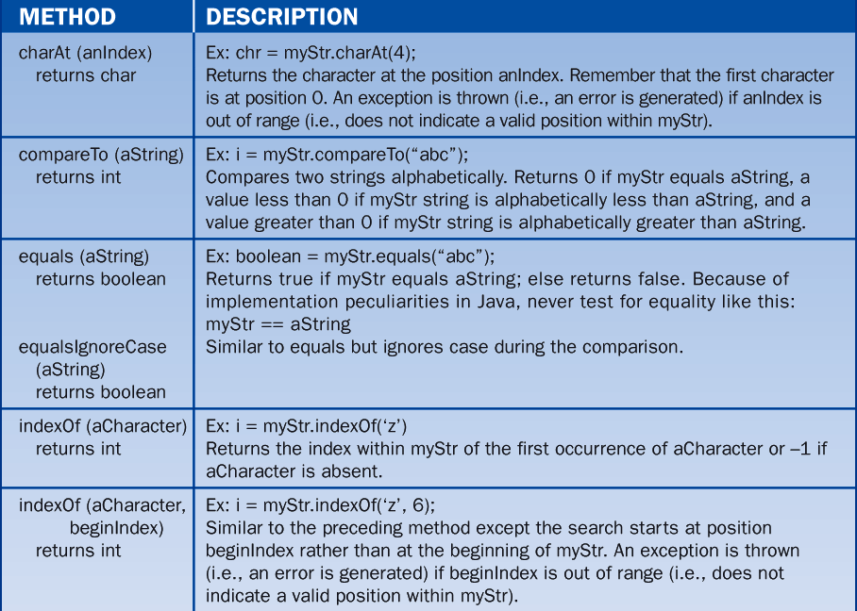
10.1 Advanced Operations on Strings

Slide 174
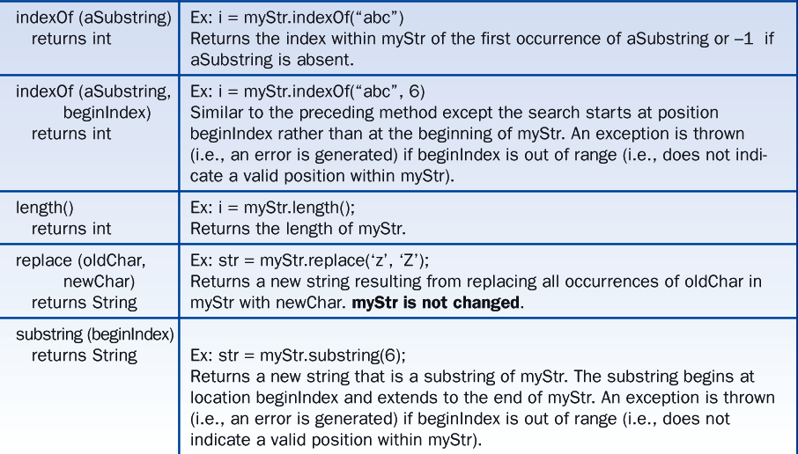
10.1 Advanced Operations on Strings

Slide 175
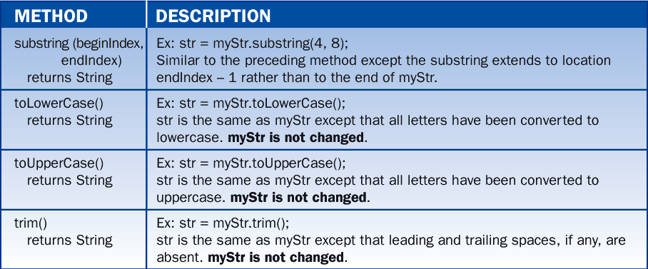
10.1 Advanced Operations on Strings

Slide 176
10.2 Searching
Linear Search
In Lesson 7, we developed the code for a method that searches an array of int for a given target value.
The method returns the index of the first matching value or -1 if the value is not in the array.
The method examines each element in sequence, starting with the first one, to determine if a target element is present.
The loop breaks if the target is found.

Slide 177
10.2 Searching
The method must examine every element to determine the absence of a target.
This method of searching is usually called linear search.
int search (int[] a, int searchValue){
for (int i = 0; i < a.length; i++)
if (a[i] == searchValue)
return i;
return -1;
}

Slide 178
10.2 Searching
SEARCHING AN ARRAY OF OBJECTS
Suppose we have an array of names that we wish to search for a given name.
A name is a String.
The change in the loop is that two string elements must be compared with the method equals instead of the operator ==.
int search (String[] a, String searchValue){
for (i = 0; i < a.length; i++)
if (a[i].equals(searchValue))
return i;
return -1;
}

Slide 179
10.2 Searching
This method can be generalized to work with any objects, not just strings.
We simply substitute Object for String in the formal parameter list.
The method still works for strings, and we can also use it to search an array of Student objects for a target student, assuming that the Student class includes an appropriate equals method.
Following is a code segment that uses this single method to search arrays of two different types:

Slide 180
10.2 Searching
String[] stringArray = {"Hi", "there", "Martin"};
Student[] studentArray = new Student[5];
Student stu = new Student("Student 1", 100, 100, 100);
for (int i = 0; i < studentArray.length; i++)
studentArray[i] = new Student("Student " + (i + 1), 100, 100, 100);
int stringPos = search(stringArray, "Martin"); // Returns 2
int studentPos = search(studentArray, stu); // Returns 0

Slide 181
10.2 Searching
Binary Search
The method of linear search works well for arrays that are fairly small (a few hundred elements).
As the array gets very large (thousands or millions of elements), the behavior of the search degrades.
When we have an array of elements that are in ascending order, such as a list of numbers or names, there is a much better way to proceed, using an algorithm known as binary search.
This method is much faster than linear search for very large arrays.

Slide 182
10.2 Searching
The basic idea of binary search is to examine the element at the array's midpoint on each pass through the search loop.
If the current element matches the target, we return its position.
If the current element is less than the target, then we search the part of the array to the right of the midpoint (containing the positions of the greater items).

Slide 183
10.2 Searching
Otherwise, we search the part of the array to the left of the midpoint (containing the positions of the lesser items).
On each pass through the loop, the current leftmost position or the current rightmost position is adjusted to track the portion of the array being searched.

Slide 184
10.2 Searching
Figure 10-1 shows a trace of a binary search for the target value 5 in the array 1 3 5 7 9 11 13 15 17.
Note that on each pass through the loop, the number of elements yet to be examined is reduced by half.
Herein lies the advantage of binary search over linear search for very large arrays.

Slide 185
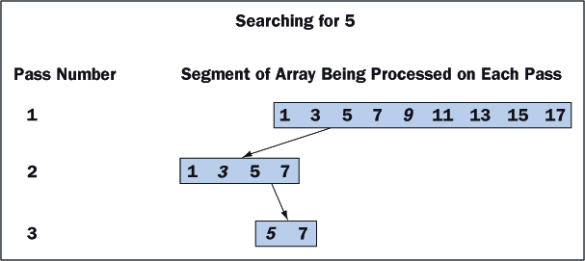
10.2 Searching

Slide 186
10.2 Searching
COMPARING OBJECTS AND THE COMPARABLE INTERFACE
When using binary search with an array of objects, we must compare two objects.
But objects do not understand the < and > operators, and we have seen that == is not a wise choice for comparing two objects for equality.
Classes that implement the Comparable interface include the method compareTo, which performs the three different comparisons.
Here is the signature of compareTo:
public int compareTo(Object other)

Slide 187
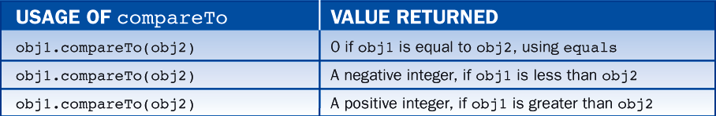
10.2 Searching
The behavior of compareTo is summarized in Table 10-2.

Slide 188
10.2 Searching
For example, the String class implements the Comparable interface; thus, the second output of the following code segment is 0:
String str = "Mary";
System.out.println(str.compareTo("Suzanne")); // Outputs -6
System.out.println(str.compareTo("Mary")); // Outputs 0
System.out.println(str.compareTo("Bob")); // Outputs 11

Slide 189
10.2 Searching
The other output integers are system dependent, but the first should be negative while the third should be positive (in the example given, they are -6 and 11, respectively).
Before sending the compareTo message to an arbitrary object, that object must be cast to Comparable, because Object does not implement the Comparable interface or include a compareTo method.
Here is the code for the binary search of an array of objects:

Slide 190
10.2 Searching
int search (Object[] a, Object searchValue){
int left = 0;
int right = a.length – 1;
while (left <= right){
int midpoint = (left + right) / 2;
int result = ((Comparable)a[midpoint]).compareTo(searchValue);
if (result == 0)
return midpoint;
else if (result < 0)
left = midpoint + 1;
else
right = midpoint – 1;
}
return -1;
}

Slide 191
10.2 Searching
IMPLEMENTING THE METHOD COMPARETO
Objects that are ordered by the relations less than, greater than, or equal to must understand the compareTo message.
Their class must implement the Comparable interface and their interface, if there is one, should also include the method compareTo.
The Student class of Lesson 5, which has no interface, is modified to support comparisons of students' names.
Below are the required changes to the code:

Slide 192
10.2 Searching
public class Student implements Comparable{
<data declarations>
public int compareTo(Object other){
// The parameter must be an instance of Student
if (! (other instanceof Student))
throw new IllegalArgumentException("Parameter must be a Student");
// Obtain the student’s name after casting the parameter
String otherName = ((Student)other).getName();
// Return the result of comparing the two students’ names
return name.compareTo(otherName);
}
<other methods>
}

Slide 193
10.3 Sorting
When the elements are in random order, we need to rearrange them before we can take advantage of any ordering.
This process is called sorting.
Suppose we have an array a of five integers that we wish to sort from smallest to largest.
In Figure 10-2, the values currently in a are as depicted on the left; we wish to end up with values as on the right.

Slide 194
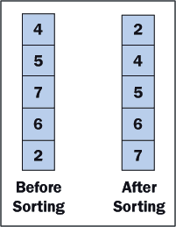
10.3 Sorting

Slide 195
10.3 Sorting
Selection Sort
The basic idea of a selection sort is:
For each index position i
Find the smallest data value in the array from positions i
through length - 1, where length is the number of data values stored.
Exchange the smallest value with the value at position i.

Slide 196
10.3 Sorting
Table 10-3 shows a trace of the elements of an array after each exchange of elements is made.
The items just swapped are marked with asterisks, and the sorted portion is shaded.
Notice that in the second and fourth passes, since the current smallest numbers are already in place, we need not exchange anything.
After the last exchange, the number at the end of the array is automatically in its proper place.

Slide 197
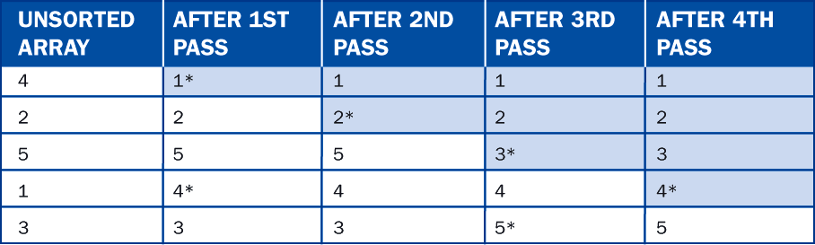
10.3 Sorting

Slide 198
10.3 Sorting
Before writing the algorithm for this sorting method, note the following:
If the array is of length n, we need n - 1 steps.
We must be able to find the smallest number.
We need to exchange appropriate array items.
When the code is written for this sort, note that strict inequality (<) rather than weak inequality (<=) is used when looking for the smallest remaining value.

Slide 199
10.3 Sorting
The algorithm to sort by selection is:
For each i from 0 to n - 1 do
Find the smallest value among a[i], a[i + 1],. . .a[n - 1]
and store the index of the smallest value in minIndex
Exchange the values of a[i] and a[index], if necessary

Slide 200
10.3 Sorting
Here we need to find the smallest value of array a.
We will incorporate this segment of code in a method, findMinimum, for the selection sort.
We will also use a method swap to exchange two elements in an array.

Slide 201
10.3 Sorting
Using these two methods, the implementation of a selection sort method is:
public static void selectionSort(int[] a){
for (int i = 0; i < a.length - 1; i++){
int minIndex = findMinimum(a, i);
if (minIndex != i)
swap(a, i, minIndex);
}
}

Slide 202
10.3 Sorting
The method for finding the minimum value in an array takes two parameters:
the array
and the position to start the search.
The method returns the index position of the minimum element in the array.
Its implementation uses a for loop:
public static int findMinimum(int[] a, int first){
int minIndex = first;
for (int i = first + 1; i < a.length; i++)
if (a[i] < a[minIndex])
minIndex = i;
return minIndex;
}

Slide 203
10.3 Sorting
The swap method exchanges the values of two array cells:
public static void swap(int[] a, int x, int y){
int temp = a[x];
a[x] = a[y];
a[y] = temp;
}

Slide 204
10.3 Sorting
Bubble Sort
Given a list of items stored in an array, a bubble sort causes a pass through the array to compare adjacent pairs of items.
Whenever two items are out of order with respect to each other, they are swapped.
The effect of such a pass through an array of items is traced in Table 10-4.
The items just swapped are marked with asterisks, and the sorted portion is shaded.

Slide 205
10.3 Sorting
Bubble Sort
Notice that after such a pass, we are assured that the array will have the item that comes last in order in the final array position.
That is, the last item will "sink" to the bottom of the array, and preceding items will gradually "percolate" to the top.

Slide 206
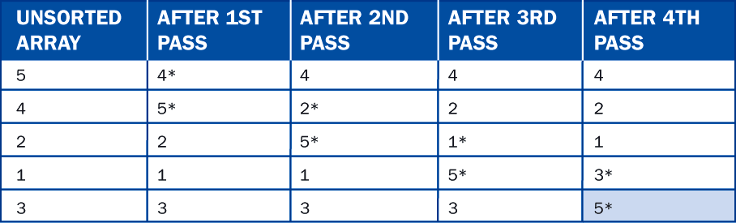
10.3 Sorting

Slide 207
10.3 Sorting
A complete Java method to implement a bubble sort for an array of integers is shown next:

Slide 208
10.3 Sorting
public static void bubbleSort(int[] a){
int k = 0;
boolean exchangeMade = true;
// Make up to n - 1 passes through array, exit early if no exchanges
// are made on previous pass
while ((k < a.length - 1) && exchangeMade){
exchangeMade = false;
k++;
for (int j = 0; j < a.length - k; j++)
if (a[j] > a[j + 1]){
swap(a, j, j + 1);
exchangeMade = true;
}
}
}

Slide 209
10.3 Sorting
Insertion Sort
The insertion sort attempts to take greater advantage of an array's partial ordering.
The goal is that on the kth pass through, the kth item among:
a[0], a[1], ..., a[k]
should be inserted into its rightful place among the first k items in the array.
This is analogous to the fashion in which many people pick up playing cards and order them in their hands.

Slide 210
10.3 Sorting
For each k from 1 to n - 1 (k is the index of array element to insert)
Set itemToInsert to a[k]
Set j to k - 1
(j starts at k - 1 and is decremented until insertion position is found)
While (insertion position not found) and (not beginning of array)
If itemToInsert < a[j]
Move a[j] to index position j + 1
Decrement j by 1
Else
The insertion position has been found
itemToInsert should be positioned at index j + 1

Slide 211
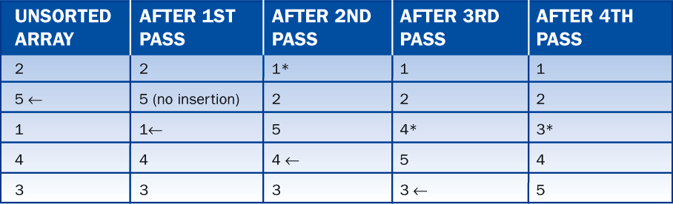
10.3 Sorting
An insertion sort for each value of k is traced in Table 10-5.
In each column of this table, the data items are sorted in order relative to each other above the item with the asterisk; below this item, the data are not affected.

Slide 212
10.3 Sorting
Sorting Arrays of Objects
Any of the sort methods can be modified to sort arrays of objects.
We assume that the objects implement the Comparable interface and support the method compareTo.
Then, we simply replace the type of all array parameters with Object and make the appropriate use of compareTo where the comparison operators are used.

Slide 213
10.3 Sorting
public static int findMinimum(Object[] a, int first){
int minIndex = first;
for (int i = first + 1; i < a.length(); i++)
if (((Comparable)a[i]).compareTo(a[minIndex]) < 0)
minIndex = i;
return minIndex;
}

Slide 214
10.4 Insertions and Removals
In this section, we show how to add or remove an element at the end of an array that is not full at arbitrary positions within an array.
For simplicity, we make four assumptions:
Arrays are of fixed size; thus, when an array becomes full, insertions are not performed.
We are working with an array of objects, although we can modify the code to cover arrays of integers, employees, or whatever element type is desired.

Slide 215
10.4 Insertions and Removals
For a successful insertions, 0 <= target index <= logical size.
The new element is inserted before the element currently at the target index, or after the last element if the target index equals the logical size.
For successful removals, 0 <= target index < logical size.
When an assumption is not satisfied, the operation is not performed and we return false; otherwise, the operation is performed and we return true.

Slide 216
10.4 Insertions and Removals
Inserting an Item into an Array at an Arbitrary Position
Inserting an item into an array differs from replacing an item in an array.
In the case of a replacement:
an item already exists at the given index position and a simple assignment suffices.
and the logical size of the array does not change.

Slide 217
10.4 Insertions and Removals
In the case of an insertion, we must do six things:
Check for available space before attempting an insertion; if there is no space, return false.
Check the validity of the target index and return false if it is not >= 0 and <= logical size.
Shift the items from the logical end of the array to the target index down by one position.
Assign the new item to the cell at the target index.
Increment the logical size by one.
Return true.
Figure 10-3 shows these steps for the insertion of an item at position 1 in an array of four items.

Slide 218
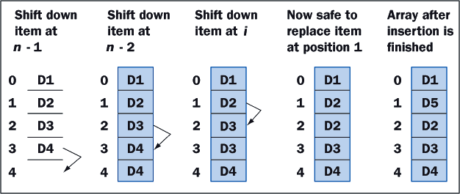
10.4 Insertions and Removals

Slide 219
10.4 Insertions and Removals
As you can see, the order in which the items are shifted is critical.
If we had started at the target index and copied down from there, we would have lost two items.
Thus, we must start at the logical end of the array and work back up to the target index, copying each item to the cell of its successor.
Next is the Java code for the insertion operation:

Slide 220
10.4 Insertions and Removals
// Check for a full array and return false if full
if (logicalSize == array.length)
return false;
// Check for valid target index return false if not valid
if (targetIndex < 0 || targetIndex > logicalSize)
return false;
// Shift items down by one position
for (int i = logicalSize; i > targetIndex; i--)
array[i] = array[i - 1];
// Add new item, increment logical size, and return true
array[targetIndex] = newItem;
logicalSize++;
return true;

Slide 221
10.4 Insertions and Removals
Removing an Item from an Array
Removing an item from an array involves the inverse process of inserting an item into the array.
Here are the steps in this process:
Check the validity of the target index and return false if it is not >= 0 and < logical size.
Shift the items from the target index to the logical end of the array up by one position.
Decrement the logical size by one.
Return true.
Figure 10-4 shows these steps for the removal of an item at position 1 in an array of five items.

Slide 222
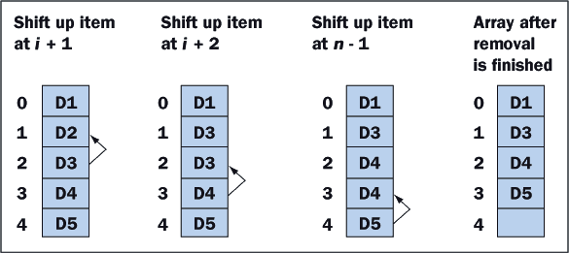
10.4 Insertions and Removals

Slide 223
10.4 Insertions and Removals
As with insertions, the order in which we shift items is critical.
For a removal, we begin at the item following the target position and move toward the logical end of the array, copying each item to the cell of its predecessor.
Here is the Java code for the removal operation:

Slide 224
10.4 Insertions and Removals
// Check for valid target index return false if not valid
if (targetIndex < 0 || targetIndex >= logicalSize)
return false;
// Shift items up by one position
for (int i = targetIndex; i < logicalSize - 1; i++)
array[i] = array[i + 1];
// Decrement logical size and return true
logicalSize--;
return true;

Slide 225
10.5 Working with Arrays of Objects
Polymorphism, Casting, and instanceof
It is quite common to declare and instantiate an array of some interface type.
For instance, below is code that reserves 10 cells for shapes:
Shape[] shapes = new Shape[10];

Slide 226
10.5 Working with Arrays of Objects
We can now store in this array instances of any class that implements Shape, such as Rect, Circle, or Wheel, as follows:
As long as we send Shape messages to the elements of this array, we can ignore the fact that they are of different concrete classes (that’s what polymorphism is all about).
shapes[0] = new Rect(20, 20, 40, 40); // Cell 0 refers to a Rect
shapes[1] = new Circle(100, 100, 20); // Cell 1 refers to a Circle
shapes[2] = new Wheel(200, 200, 20, 6); // Cell 2 refers to a Wheel

Slide 227
10.5 Working with Arrays of Objects
Let us now draw all the shapes in the array:
Pen pen = new StandardPen();
for (int i = 0; i < 3; i++)
shapes[i].draw(pen);

Slide 228
10.5 Working with Arrays of Objects
Let us assume that we know the position of the wheel object in the array (in our example, it's at position 2).
Then, to set its spokes to 5, we perform the following steps:
Access the array element with the subscript.
Cast the element, which is masquerading as a Shape, to a Wheel.
Send the setSpokes(5) message to the result.
Here is the code:
((Wheel) shapes[2]).setSpokes(5);

Slide 229
10.5 Working with Arrays of Objects
Note the use of parentheses to override the precedence of the method selector, which would otherwise be run before the cast operation.
Failure to cast in this code causes a compile-time error.
Suppose we don't know the position of a wheel in the array of shapes, but we wish to set the spokes of each wheel to 5.
We must first determine that a shape is a wheel before casting, and Java's instanceof operator comes to our rescue.

Slide 230
10.5 Working with Arrays of Objects
Here is a loop that solves the problem:
for (int i = 0; i < shapes.length; i++)
if (shapes[i] instanceof Wheel)
((Wheel) shapes[i]).setSpokes(5);

Slide 231
10.5 Working with Arrays of Objects
Let us now summarize the use of objects in an array by making two fundamental points:
When the element type of an array is a reference type or interface, objects of those types or any subtype (subclass or implementing class) can be directly inserted into the array.
After accessing an object in an array, care must be taken to send it the appropriate messages or to cast it down to a type that can receive the appropriate messages.

Slide 232
10.6 BreezySwing: Menus, Scrolling List Boxes, and Dialogs
Menus
Menus provide a convenient mechanism for entering commands into a program.
A menu system consists of a menu bar, a number of menus, and for each menu, several selections.
It is also possible to have submenus.
To add a menu system to an application, declare a menu item object for each menu selection.

Slide 233
10.6 BreezySwing: Menus, Scrolling List Boxes, and Dialogs
Suppose we want to move the editing commands for the student test scores program to a menu.
We would like a menu of commands to sort the students by name, by high score, and by average.
The following code adds the two menus to the application's interface:

Slide 234
10.6 BreezySwing: Menus, Scrolling List Boxes, and Dialogs
// Declare menu item variables
JMenuItem addMI, modifyMI, deleteMI,
sortByNameMI, sortByHighScoreMI, sortByAverageScoreMI;
public SomeApplication(){
// Instantiate menu items
addMI = addMenuItem ("Edit", "Add");
modifyMI = addMenuItem ("Edit", "Modify");
deleteMI = addMenuItem ("Edit", "Delete");
sortByNameMI = addMenuItem ("Sort", "By Name");
sortByHighScoreMI = addMenuItem ("Sort", "By High Score");
sortByAverageScoreMI = addMenuItem ("Sort", "By Average Score ");
}

Slide 235
10.6 BreezySwing: Menus, Scrolling List Boxes, and Dialogs
The first menu is called Edit and has three items.
The second, called Sort, also has three.
When the user selects a menu item, the JVM sends a menuItemSelected message to the application, so we need to write the corresponding method.
public void menuItemSelected (JMenuItem menuItemObj){
if (menuItemObj == addMI)
add();
else if (menuItemObj == modifyMI){
modify();
. . .
etc.
}

Slide 236
10.6 BreezySwing: Menus, Scrolling List Boxes, and Dialogs
Scrolling Lists
Scrolling lists are instances of the class JList as defined in the package javax.swing.
When the user clicks on an entry in a scrolling list, the entry is automatically highlighted, thus giving the user visual feedback.

Slide 237
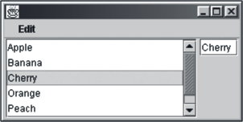
10.6 BreezySwing: Menus, Scrolling List Boxes, and Dialogs
Figure 10-5 illustrates the use of a scrolling list.

Slide 238
10.6 BreezySwing: Menus, Scrolling List Boxes, and Dialogs
Associated with a scrolling list window object is a list model, which contains the data displayed in the scrolling list.
When the programmer adds a scrolling list to an interface with the method addList, BreezySwing automatically creates an instance of the class DefaultListModel and associates it with the scrolling list.
The programmer can then send messages to either the scrolling list or its model to accomplish such tasks as asking which item, if any, has been selected or selecting an item.
In addition, a program can add entries to and remove entries from a scrolling list.

Slide 239
10.6 BreezySwing: Menus, Scrolling List Boxes, and Dialogs
Table 10-6 describes many of the most useful methods for manipulating a scrolling list.
Table 10-7 describes useful methods for its model.
Table 10-8 describes the methods, included in the classes GBFrame, GBDialog, and GBApplet, for responding to single and double click events.

Slide 240
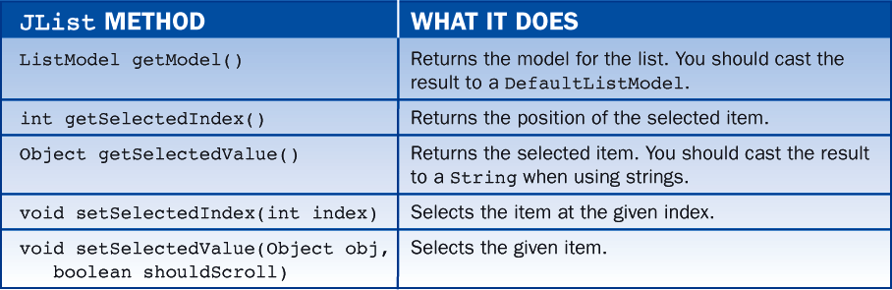
10.6 BreezySwing: Menus, Scrolling List Boxes, and Dialogs

Slide 241
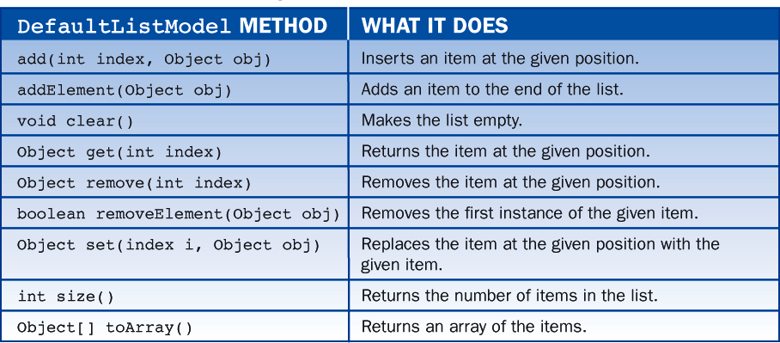
10.6 BreezySwing: Menus, Scrolling List Boxes, and Dialogs

Slide 242
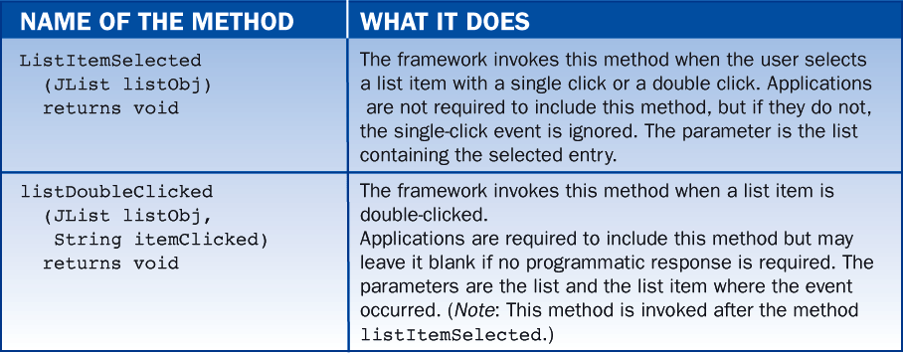
10.6 BreezySwing: Menus, Scrolling List Boxes, and Dialogs

Slide 243
10.6 BreezySwing: Menus, Scrolling List Boxes, and Dialogs
Dialogs
Usually, a dialog is modal, meaning that the rest of the application is inaccessible as long as the dialog is active.
Users quit most dialogs by clicking an OK or a Cancel button.
The OK button closes a dialog and transmits data entered by the user back to the rest of the application
The Cancel button closes a dialog and discards the data.

Slide 244
10.6 BreezySwing: Menus, Scrolling List Boxes, and Dialogs
Dialogs are implemented in much the same way as application windows, but by extending the class GBDialog rather than GBFrame.
Figure 10-6 shows the application's main window and accompanying dialog.
The dialog is activated when the user selects menu option Edit/Add or Edit/Modify, at which point the dialog is activated and passed a student object.
The dialog then retains control of the application until the user clicks the dialog's OK or Cancel button.

Slide 245
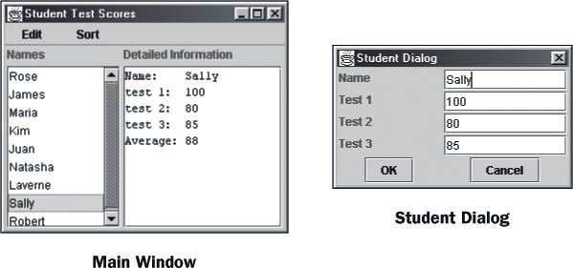
10.6 BreezySwing: Menus, Scrolling List Boxes, and Dialogs
If the user clicks OK, the student object is updated with the data on the screen, but if the user clicks Cancel, no changes are made to the student object.
In either event, the dialog then closes and control returns to the main window.

Slide 246
10.7 The Class java.util.ArrayList
Arrays are easiest to use when:
We know how many data elements will be added to them, so we don't run out of cells or waste any cells
We know they are full
When these conditions do not hold, clients must
Find a way to increase the length of the array when it becomes full or shrink it when many cells become unoccupied
Track the array's logical size with a separate variable

Slide 247
10.7 The Class java.util.ArrayList
Like most object-oriented languages, Java provides a wide range of classes for maintaining collections of objects.
The collection class most like an array is called ArrayList and is included in the package java.util.

Slide 248
10.7 The Class java.util.ArrayList
Declaring and Instantiating an Array List
An array list is an object, so it is instantiated like any other object, as in the following example:
Note that no initial length is specified in the array.
An array list tracks its own physical size and logical size, which initially is 0.
When a client inserts objects into an array list, the list automatically updates its logical size and adds cells to accommodate new objects if necessary.
import java.util.ArrayList;
ArrayList list = new ArrayList();

Slide 249
10.7 The Class java.util.ArrayList
Using ArrayList Methods
The programmer manipulates an array list by sending it messages.
There are methods for examining an array list's logical size, testing it for emptiness (it's never full, at least in theory), insertions, removals, examining or replacing elements at given positions, and searching for a given element.
Table 10-12 contains descriptions of these commonly used methods.

Slide 250
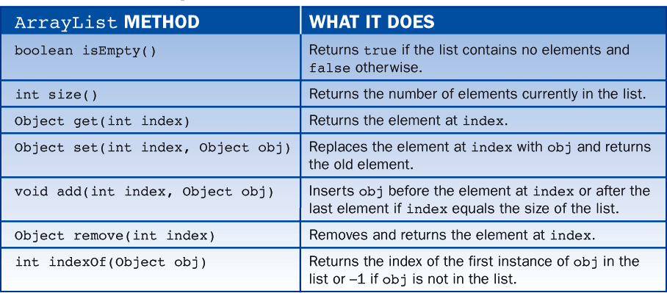
10.7 The Class java.util.ArrayList

Slide 251
10.7 The Class java.util.ArrayList
The next code segment performs some example searches:
Our final code segment removes the first element from the list and displays that element and the list's size after each removal, until the list becomes empty:
System.out.println(list.indexOf("Item3")); // Displays 2
System.out.println(list.indexOf("Martin")); // Displays -1
while (! list.isEmpty()){
Object obj = list.remove(0);
System.out.println(obj);
System.out.println("Size: " + list.size());
}

Slide 252
10.7 The Class java.util.ArrayList
Array Lists and Objects
The array list is a powerful data structure, however, there are some restrictions on their use:
an array list can contain only objects, not primitive types.
although it's easy to insert any object into an array list, care must be taken when manipulating objects extracted from an array list.
Remember that the elements come out as objects, which must be cast down to the appropriate classes before they are sent messages.

Slide 253
10.7 The Class java.util.ArrayList
Primitive Types and Wrapper Classes
Java distinguishes between primitive data types (numbers, characters, Booleans) and objects (instances of String, Employee, Student, etc.).
Variables and arrays can refer either to primitive data types or to objects, as in:
int x; // An integer variable
int nums[]; // An array of integers
Student student; // A Student variable
Student students[]; // An array of Students

Slide 254
10.7 The Class java.util.ArrayList
The items in an array list must all be objects:
ArrayList list = new ArrayList();
list.add (3.14); // Invalid (compile-time error), 3.14 is not
// an object
list.add (new Student()); // Valid

Slide 255
10.7 The Class java.util.ArrayList
There are occasions when we desire to store primitive data types in lists, which we can do if we first convert them to objects.
Java provides wrapper classes for this purpose.
Here is an example that illustrates how to convert an integer to and from its wrapper class Integer:
Integer intObject; // Variable for wrapper object
int i, j;
i = 3;
intObject = new Integer (i); // Wrap 3 in an Integer wrapper object
j = intObject.intValue(); // Unwrap 3 from the Integer wrapper object

Slide 256
10.7 The Class java.util.ArrayList
As you can see from this code, the wrapper object intObject serves as a container in which the integer value 3 is stored or wrapped.
The intValue method retrieves or unwraps the value in intObject.
All wrapper objects understand the equals and compareTo messages, so they can be included in arrays that are searched and sorted.
However, they cannot be used directly as operands in standard arithmetic expressions.
Usually, casting as well as unwrapping is necessary.

Slide 257
10.7 The Class java.util.ArrayList
For example, the next code segment shows how to compute the sum of the first two integers in an array list:
ArrayList list = new ArrayList();
// Wrap ints before insertion
list.add(0, new Integer(55));
list.add(1, new Integer(66));
// They come out as Objects, so cast down before unwrapping
int sum = ((Integer)list.get(0)).intValue() +
((Integer)list.get(0)).intValue();

Slide 258
10.7 The Class java.util.ArrayList
Like strings, wrapper objects are immutable; once they have been instantiated, the primitive values they contain cannot be changed.
The wrapper classes for all the primitive data types are listed in Table 10-13.

Slide 259
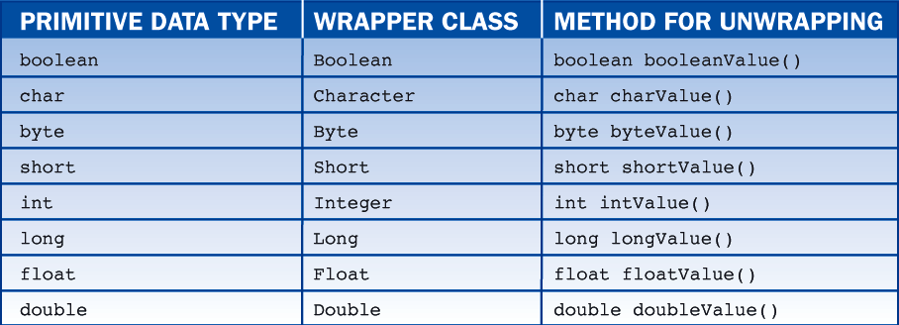
10.7 The Class java.util.ArrayList

Slide 260
Lesson 11: Recursion, Complexity, and Searching and Sorting

Slide 261
Lesson 11: Recursion, Complexity, and Searching and Sorting
Objectives:
Design and implement a recursive method to solve a problem.
Understand the similarities and differences between recursive and iterative solutions of a problem.
Check and test a recursive method for correctness.
Understand how a computer executes a recursive method.

Slide 262
Lesson 11: Recursion, Complexity, and Searching and Sorting
Objectives:
Perform a simple complexity analysis of an algorithm using big-O notation.
Recognize some typical orders of complexity.
Understand the behavior of a complex sort algorithm such as the quicksort.

Slide 263
Lesson 11: Recursion, Complexity, and Searching and Sorting
Vocabulary:
activation record
big-O notation
binary search algorithm
call stack
complexity analysis
infinite recursion
iterative process
quicksort
recursive method
recursive step
stack
stack overflow error
stopping state
tail-recursive

Slide 264
11.1 Recursion
A recursive algorithm is one that refers to itself by name in a manner that appears to be circular.
Everyday algorithms, such as a recipe to bake cake or instructions to change car oil, are not expressed recursively, but recursive algorithms are common in computer science.
Complexity analysis is concerned with determining an algorithm's efficiency.

Slide 265
11.1 Recursion
Java's looping constructs make implementing this process easy.
sum(1) = 1
sum(N) = N + sum(N - 1) if N > 1
Consider what happens when the definition is applied to the problem of calculating sum(4):
sum(4) = 4 + sum(3)
= 4 + 3 + sum(2)
= 4 + 3 + 2 + sum(1)
= 4 + 3 + 2 + 1
The fact that sum(1) is defined to be 1 without making reference to further invocations of sum saves the process from going on forever and the definition from being circular.

Slide 266
11.1 Recursion
Functions that are defined in terms of themselves in this way are called recursive.
Here, for example, are two ways to express the definition of factorial,
the first iterative and
the second recursive:
factorial(N) = 1 * 2 * 3 * ... * N, where N >= 1
factorial(1) = 1
factorial(N) = N * factorial(N - 1) if N > 1
In this case the iterative definition is more familiar and thus easier to understand than the recursive one; however, such is not always the case.

Slide 267
11.1 Recursion
Consider the definition of Fibonacci numbers below.
The first and second numbers in the Fibonacci sequence are 1.
Thereafter, each number is the sum of its two immediate predecessors, as follows:
1 1 2 3 5 8 13 21 34 55 89 144 233 ...
Or in other words:
fibonacci(1) = 1
fibonacci(2) = 1
fibonacci(N) = fibonacci(N - 1) + fibonacci(N - 2) if N > 2
This is a recursive definition, and it is hard to imagine how one could express it nonrecursively.

Slide 268
11.1 Recursion
Recursion involves two factors:
some function f(N) is expressed in terms of f(N - 1)and perhaps f(N - 2), and so on.
Second, to prevent the definition from being circular, f(1) and perhaps f(2), and so on, are defined explicitly.

Slide 269
11.1 Recursion
Implementing Recursion
Given a recursive definition of some process, it is usually easy to write a recursive method that implements it.
A method is said to be recursive if it calls itself.
Start with a method that computes factorials.
int factorial (int n){
//Precondition n >= 1
if (n == 1)
return 1;
else
return n * factorial (n - 1);
}

Slide 270
11.1 Recursion
For comparison, here is an iterative version of the method.
As you can see, it is slightly longer and no easier to understand.
int factorial (int n){
int product = 1;
for (int i = 2; i <= n; i++)
product = product * i;
}
return product;
}

Slide 271
11.1 Recursion
As a second example of recursion, below is a method that calculates Fibonacci numbers:
int fibonacci (int n){
if (n <= 2)
return 1;
else
return fibonacci (n - 1) + fibonacci (n - 2);
}

Slide 272
11.1 Recursion
Guidelines for Writing Recursive Methods
A recursive method must have a well-defined termination or stopping state.
For the factorial method, this was expressed in the lines:
The recursive step, in which the method calls itself, must eventually lead to the stopping state.
For the factorial method, the recursive step was expressed in the lines:
if (n == 1)
return 1;
else
return n * factorial(n - 1);

Slide 273
11.1 Recursion
Because each invocation of the factorial method is passed a smaller value, eventually the stopping state must be reached.
Had we accidentally written:
the method would describe an infinite recursion.
Eventually, the user would notice and terminate the program, or else the Java interpreter would run out memory, and the program would terminate with a stack overflow error.
else
return n * factorial(n + 1);

Slide 274
11.1 Recursion
Here is a subtler example of a malformed recursive method:
This method works fine if n is odd, but when n is even, the method passes through the stopping state and keeps on going.
int badMethod (int n){
if (n == 1)
return 1;
else
return n * badMethod(n - 2);
}

Slide 275
11.1 Recursion
Runtime Support for Recursive Methods
Computers provide the following support at run time for method calls:
A large storage area known as a call stack is created at program startup.
When a method is called, an activation record is added to the top of the call stack.
The activation record contains, among other things, space for the parameters passed to the method, the method's local variables, and the value returned by the method.
When a method returns, its activation record is removed from the top of the stack.

Slide 276
11.1 Recursion
An activation record for this method requires cells for the following items:
The value of the parameter n
The return value of factorial.
Suppose we call factorial(4). A trace of the state of the call stack during calls to factorial down to factorial(1) is shown in Figure 11-1.
int factorial (int n){
if (n <= 1)
return 1;
else
return n * factorial (n - 1);
}

Slide 277
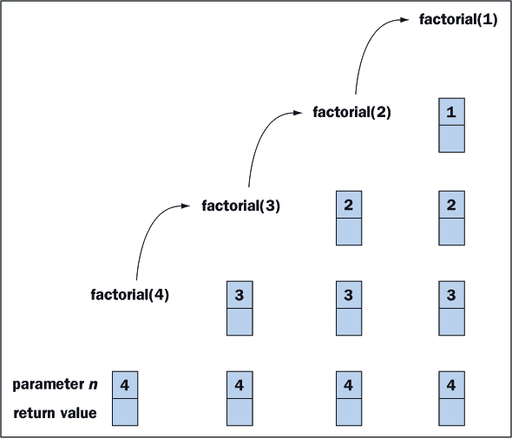
11.1 Recursion

Slide 278
11.1 Recursion
When to Use Recursion
Recursion can always be used in place of iteration, and vice versa.
Recursion involves a method repeatedly calling itself.
Executing a method call and the corresponding return statement usually takes longer than incrementing and testing a loop control variable.

Slide 279
11.1 Recursion
A method call ties up some memory that is not freed until the method completes its task.
Naïve programmers often state these facts as an argument against ever using recursion.
However, there are many situations in which recursion provides the clearest, shortest, and most elegant solution to a programming task.

Slide 280
11.1 Recursion
TOWERS OF HANOI
Many centuries ago in the city of Hanoi, the monks in a certain monastery attempted to solve a puzzle.
Sixty-four rings of increasing size had been placed on a vertical wooden peg (Figure 11-3).
Beside it were two other pegs, and the monks were attempting to move all the rings from the first to the third peg - subject to two constraints:
only one ring could be moved at a time
a ring could be moved to any peg, provided it was not placed on top of a smaller ring.

Slide 281
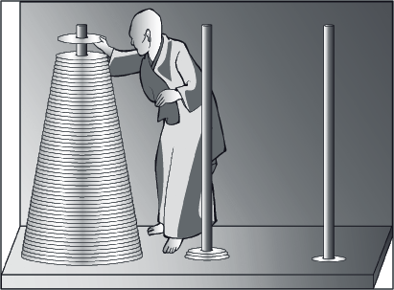
11.1 Recursion

Slide 282
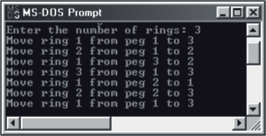
11.1 Recursion
Figure 11-4 shows the result of running the program with three rings.
In the output, the rings are numbered from smallest (1) to largest (3).

Slide 283
11.1 Recursion
The program uses a recursive method called move.
The first time this method is called, it is asked to move all N rings from peg 1 to peg 3.
The method then proceeds by calling itself to move the top N - 1 rings to peg 2, prints a message to move the largest ring from peg 1 to peg 3, and finally calls itself again to move the N - 1 rings from peg 2 to peg 3.

Slide 284
11.2 Complexity Analysis
Examining the effect on the method of increasing the quantity of data processed is called complexity analysis.
Sum Methods
The Sum method processes an array whose size can be varied.
To determine the method’s execution time, beside each statement we place a symbol (t1, t2, etc.) that indicates the time needed to execute the statement.
Because we have no way of knowing what these times really are, we can do no better.

Slide 285
11.2 Complexity Analysis
int sum (int[] a){
int i, result;
result = 0; // Assignment: time = t1
for (i = 0; i < a.length; i++){ // Overhead for going once around the
// loop: time = t2
result += a[i]; // Assignment: time = t3
}
return result; // Return: time = t4
}

Slide 286
11.2 Complexity Analysis
Adding these times together and remembering that the method goes around the loop n times, where n represents the array's size, yields:
executionTime
= t1 + n * (t2 + t3) + t4
= k1 + n * k2
where k1 and k2 are method-dependent constants
≈ n * k2
for large values of n

Slide 287
11.2 Complexity Analysis
Thus, the execution time is linearly dependent on the array's length, and as the array's length increases, the contribution of k1 becomes negligible.
Consequently, we can say with reasonable accuracy that doubling the length of the array doubles the execution time of the method.
Computer scientists express this linear relationship between the array's length and execution time using big-O notation:
executionTime = O(n).

Slide 288
11.2 Complexity Analysis
Phrased differently, the execution time is of order n.
Observe that from the perspective of big-O notation, we make no distinction between a method whose execution time is:
1000000 + 1000000*n
and one whose execution time is
n / 1000000
although from a practical perspective the difference is enormous.

Slide 289
11.2 Complexity Analysis
Complexity analysis can also be applied to recursive methods.
Here is a recursive version of the sum method. It too is O(n).
int sum (int[] a, int i){
if (i >= a.length) // Comparison: t1
return 0; // Return: t2
else
return a[i] + sum (a, i + 1); // Call and return: t3
}

Slide 290
11.2 Complexity Analysis
The method is called initially with i = 0.
A single activation of the method takes time:
t1 + t2 if i >= a.length
and
t1 + t3 if i < a.length.
The first case occurs once and the second case occurs the a.length times that the method calls itself recursively.
Thus, if n equals a.length, then:
executionTime
= t1 + t2 + n * (t1 + t3)
= k1 + n * k2
where k1 and k2 are method-dependent constants
= O(n)

Slide 291
11.2 Complexity Analysis
Following is a linear search method form Lesson 10:
int search (int[] a, int searchValue){
for (i = 0; i < a.length; i++) // Loop overhead: t1
if (a[i] == searchValue) // Comparison: t2
return i; // Return point 1: t3
return location; // Return point 2: t4
}

Slide 292
11.2 Complexity Analysis
The analysis of the linear search method is slightly more complex than that of the sum method.
Each time through the loop, a comparison is made.
If and when a match is found, the method returns from the loop with the search value's index.
executionTime
= (n / 2) * (t1 + t2) + t3
= n * k1 + k2 where k1 and k2 are method-dependent constants.
= O(n)

Slide 293
11.2 Complexity Analysis
Now let us look at a method that processes a two-dimensional array:
int[] sumRows (int[][] a){
int i, j;
int[] rowSum = new int[a.length]; // Instantiation: t1
for (i = 0; i < a.length; i++){ // Loop overhead: t2
for (j = 0; j < a[i].length; j++){ // Loop overhead: t3
rowSum[i] += a[i][j]; // Assignment: t4
}
}
return rowSum; // Return: t5
}

Slide 294
11.2 Complexity Analysis
Let n represent the total number of elements in the array and r the number of rows.
For the sake of simplicity, we assume that each row has the same number of elements, say, c.
The execution time can be written as:
executionTime
= t1 + r * (t2 + c * (t3 + t4)) + t5
= (k1 + n * k2) + (n/c) * t2 + n * (t3 + t4) + t5
where r = n/c
= (k1 + n * k2) + n * (t2 / c + t3 + t4) + t5
= k2 + n * k3
where k1, k2, k3, and k4 are constants
= O(n)

Slide 295
11.2 Complexity Analysis
An O(n²) Method
Not all array processing methods are O(n), as an examination of the bubbleSort method reveals.
This one does not track whether an exchange was made in the nested loop, so there is no early exit.

Slide 296
11.2 Complexity Analysis
void bubbleSort(int[] a){
int k = 0;
// Make n - 1 passes through array
while (k < a.length() - 1){ // Loop overhead: t1
k++;
for (int j = 0; j < a.length() - k; j++) // Loop overhead: t2
if (a[j] > a[j + 1]) // Comparison: t3
swap(a, j, j + 1); // Assignments: t4
}
}

Slide 297
11.2 Complexity Analysis
The outer loop of the sort method executes n - 1 times, where n is the length of the array.
Each time the inner loop is activated, it iterates a different number of times.
On the first activation it iterates n - 1 times, on the second n - 2, and so on.
On the last activation it iterates once.
The average number of iterations is n / 2.
On some iterations, elements a[i] and a[j] are interchanged in time t4, and on other iterations, they are not.
So on the average iteration, let's say time t5 is spent doing an interchange.

Slide 298
11.2 Complexity Analysis
The execution time of the method can now be expressed as:
executionTime
= t1 + (n - 1) * (t1 + (n / 2) * (t2 + t3 + t5))
= t1 + n * t1 – t1 + (n * n / 2) * (t2 + t3 + t4) –
(n / 2) * (t2 + t3 + t4)
= k1 + n * k2 + n * n * k3
≈ n * n * k3 for large values of n
= O(n²)

Slide 299
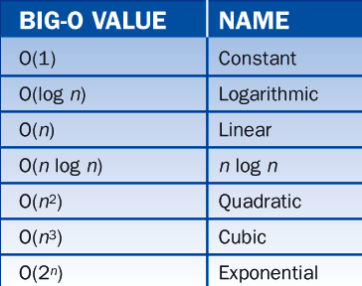
11.2 Complexity Analysis
Common Big-O Values
Table 11-1 lists some other common big-O values together with their names.

Slide 300
11.2 Complexity Analysis
The values in Table 11-1 are listed from "best" to "worst."
Given two methods that perform the same task, but in different ways, we tend to prefer the one that is O(n) over the one that is O(n2).
Suppose that the exact run time of two methods is:
10,000 + 400n // method 1
and
10,000 + n² // method 2

Slide 301
11.2 Complexity Analysis
For small values of n, method 2 is faster than method 1
For all values of n larger than a certain threshold, method 1 is faster.
The threshold in this example is 400.
So if you know ahead of time that n will always be less than 400, you are advised to use method 2, but if n will have a large range of values, method 1 is superior.

Slide 302
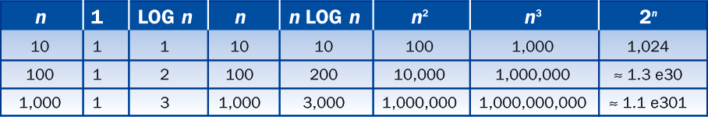
11.2 Complexity Analysis
To get a feeling for how the common big-O values vary with n, consider Table 11-2.
We use base 10 logarithms.
This table vividly demonstrates that a method might be useful for small values of n, but totally worthless for large values.

Slide 303
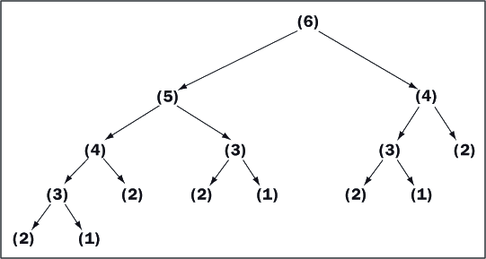
11.2 Complexity Analysis
An O(r^{n}) Method
Figure 11-7 shows the calls involved when we use the recursive method to compute the sixth Fibonacci number.

Slide 304
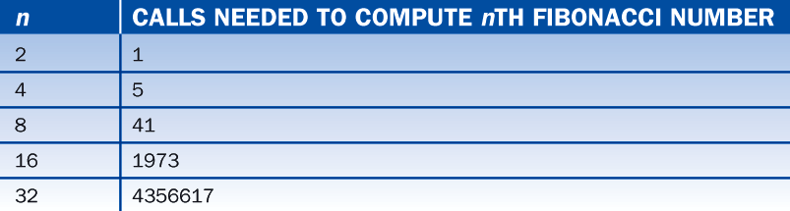
11.2 Complexity Analysis
Table 11-3 shows the number of calls as a function of n.

Slide 305
11.3 Binary Search
If we know in advance that a list of numbers is in ascending order, we can quickly zero in on the search value or determine that it is absent using the binary search algorithm.
We shall show that this algorithm is O(log n).

Slide 306
11.3 Binary Search
Figure 11-8 is an illustration of the binary search algorithm.
We are looking for the number 320.
At each step we highlight the sublist that might still contain 320.
At each step, all the numbers are invisible except the one in the middle of the sublist, which is the one that we are comparing to 320.

Slide 307
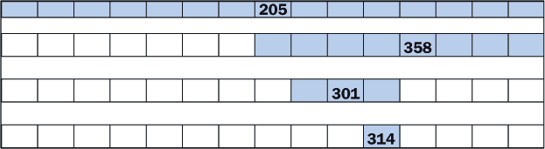
11.3 Binary Search

Slide 308
11.3 Binary Search
After only four steps, we have determined that 320 is not in the list.
Had the search value been 205, 358, 301, or 314 we would have located it in four or fewer steps.
The binary search algorithm is guaranteed to search a list of 15 sorted elements in a maximum of four steps.
Incidentally, the list with all the numbers visible looks like Figure 11-9.

Slide 309
11.3 Binary Search
Table 11-4 shows the relationship between a list's length and the maximum number of steps needed to search the list.
To obtain the numbers in the second column, add 1 to the larger numbers in the first column and take the logarithm base 2.
A method that implements a binary search is O(log n).

Slide 310
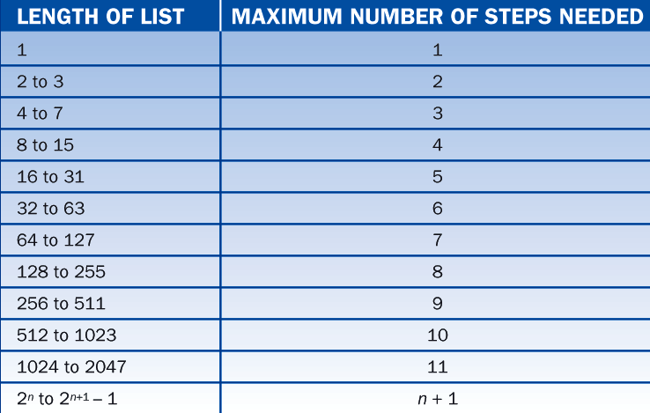
11.3 Binary Search

Slide 311
11.3 Binary Search
We now present two versions of the binary search algorithm, one iterative and one recursive, and both O(log n).
// Iterative binary search of an ascending array
int search (int[] a, int searchValue){
int left = 0; // Establish the initial
int right = a.length – 1; // endpoints of the array
while (left <= right){ // Loop until the endpoints cross
int midpoint = (left + right) / 2; // Compute the current midpoint
if (a[midpoint] == searchValue) // Target found; return its index
return midpoint;
else if (a[midpoint] < searchValue) // Target to right of midpoint
left = midpoint + 1;
else // Target to left of midpoint
right = midpoint – 1;
}
return -1; // Target not found
}

Slide 312
11.3 Binary Search
Figure 11-10 illustrates an iterative search for 320 in the list of 15 elements.
L, M, and R are abbreviations for left, midpoint, and right.
At each step, the figure shows how these variables change.
Because 320 is absent from the list, eventually (left > right) and the method returns –1.

Slide 313
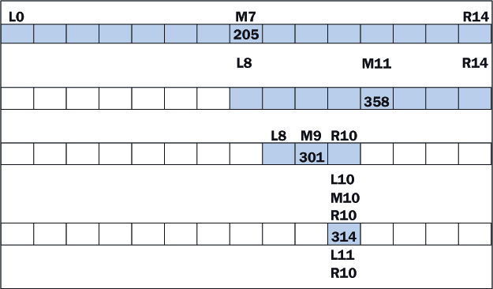
11.3 Binary Search

Slide 314
11.3 Binary Search
Now for the recursive version of the algorithm:
// Recursive binary search of an ascending array
int search (int[] a, int searchValue, int left, int right){
if (left > right)
return –1;
else{
int midpoint = (left + right) / 2;
if (a[midpoint] == searchValue)
return midpoint;
else if (a[midpoint] < searchValue)
return search (a, searchValue, midpoint + 1, right);
else
return search (a, searchValue, left, midpoint - 1);
}
}

Slide 315
11.3 Binary Search
The two versions are similar, and they use the variables left, midpoint, and right in the same way.
They, of course, differ in that one uses a loop and the other uses recursion.
We conclude the discussion by showing how the two methods are called:
int[] a = {15,36,87,95,100,110,194,205,297,301,314,358,451,467,486};
int x = 320;
int location;
location = search (a, x); // Iterative version
location = search (a, x, 0, a.length - 1); // Recursive version

Slide 316
11.4 Quicksort
There are also several much better algorithms that are O(n log n).
Quicksort is one of the simplest.
The general idea behind quicksort is this:
Break an array into two parts
Move elements around so that all the larger values are in one end and all the smaller values are in the other.
Each of the two parts is then subdivided in the same manner, and so on until the subparts contain only a single value, at which point the array is sorted.

Slide 317
11.4 Quicksort
To illustrate the process, suppose an unsorted array, called a, looks like Figure 11-11.

Slide 318

11.4 Quicksort
Phase 1
If the length of the array is less than 2, then done.
Locate the value in the middle of the array and call it the pivot. The pivot is 7 in this example.
Tag the elements at the left and right ends of the array as i and j, respectively.

Slide 319

11.4 Quicksort
While a[i] < pivot value, increment i.
While a[j] >= pivot value, decrement j:

Slide 320

11.4 Quicksort
If i > j then
end the phase
else
interchange a[i] and a[j]:

Slide 321

11.4 Quicksort
Increment i and decrement j.
If i > j then end the phase:

Slide 322

11.4 Quicksort
Repeat step 4, i.e.,
While a[i] < pivot value, increment i
While a[j] >= pivot value, decrement j:

Slide 323

11.4 Quicksort
Repeat step 5, i.e.,
If i > j then
end the phase
else
interchange a[i] and a[j]:

Slide 324

11.4 Quicksort
Repeat step 6, i.e.,
Increment i and decrement j.
If i < j then end the phase:

Slide 325

11.4 Quicksort
Repeat step 4, i.e.,
While a[i] < pivot value, increment i
While a[j] >= pivot value, decrement j:

Slide 326
11.4 Quicksort
Repeat step 5, i.e.,
If i > j then
end the phase
else
interchange a[i] and a[j].

Slide 327
11.4 Quicksort
This ends the phase.
Split the array into the two subarrays a[0..j] and a[i..10].
For clarity, the left subarray is shaded.
Notice that all the elements in the left subarray are less than or equal to the pivot, and those in the right are greater than or equal.

Slide 328
11.4 Quicksort
Phase 2 and Onward
Reapply the process to the left and right subarrays and then divide each subarray in two and so on until the subarrays have lengths of at most one.

Slide 329
11.4 Quicksort
Complexity Analysis
During phase 1, i and j moved toward each other.
At each move, either an array element is compared to the pivot or an interchange takes place.
As soon as i and j pass each other, the process stops.
Thus, the amount of work during phase 1 is proportional to n, the array's length.

Slide 330
11.4 Quicksort
The amount of work in phase 2 is proportional to the left subarray's length plus the right subarray's length, which together yield n.
When these subarrays are divided, there are four pieces whose combined length is n, so the combined work is proportional to n yet again.
At successive phases, the array is divided into more pieces, but the total work remains proportional to n.

Slide 331
11.4 Quicksort
To complete the analysis, we need to determine how many times the arrays are subdivided.
When we divide an array in half repeatedly, we arrive at a single element in about log₂ n steps.
Thus the algorithm is O(n log n) in the best case.
In the worst case, the algorithm is O(n²).

Slide 332
11.4 Quicksort
Implementation
The quicksort algorithm can be coded using either an iterative or a recursive approach.
The iterative approach also requires a data structure called a stack.
The following example implements the quicksort algorithm recursively:

Slide 333
11.4 Quicksort
void quickSort (int[] a, int left, int right){
if (left >= right) return;
int i = left;
int j = right;
int pivotValue = a[(left + right) / 2];
while (i < j){
while (a[i] < pivotValue) i++;
while (pivotValue < a[j]) j--;
if (i <= j){
int temp = a[i];
a[i] = a[j];
a[j] = temp;
i++;
j--;
}
}
quickSort (a, left, j);
quickSort (a, i, right);
}

